Slide 1
The Africa Climate Resilient Investment Facility (AFRI-RES) PIDA PAP II Training Programme
Module 2: Using the AFRI-RES Resilience Booster Tool

Slide 2
Structure of the Module
Aims of the Module and Training
Introduction to the AFRI-RES resilience booster tool
Key Concepts for using the tool
Inputs needed to utilize the tool
Expected outputs from the tool
Exercise: Using the tool

Slide 3
Aims of AFRI-RES & the Training Programme
The Africa Climate Resilient Investment Facility (AFRI-RES) Objective: Strengthen the capacity of African institutions (national governments, river basin organizations, Regional Economic Communities, power pools and development practitioners) to plan, design, and implement investments resilient to climate variability and change in selected sectors
Training Programme Objectives
are well informed of climate risks to Africa’s infrastructure
understand climate resilience and its attributes and guidelines
are trained on the use of the resilience attributes and climate resilient guidelines roads and transport sector already developed through the World Bank under the AFRI-RES programme
can monitor and evaluate projects for adopting climate resilience attributes to ensure intended impacts of the projects
promote climate resilient measures to improve the quality and sustainability of projects
increase capacity on adaptive management of projects to integrate new information and knowledge on climate resilience relevant for the projects

Slide 4

Aims of Module 2
Upon the completion of Module 2, participants will understand how to utilize the AFRI-RES Resilience Booster Tool to strengthen the resilience attributes for the roads projects in PIDA PAP II.

Slide 5
What is the AFRI-RES Resilience Booster Tool
It integrates resilience attributes as part of the project’s design and implementation to contribute in four main ways:
Strengthen Project Design through Resilience Pathways
Meet national climate commitments
Track Progress on Resilience Impact
Develop a bottom-up, intuitive approach to strengthen resilience
Notes:
The integration of resilience attributes can help project teams in the design of interventions/activities that can bolster resilience pathways. By identifying linkages between the project’s activities, resilience attributes and core resilience capacities, the project team can provide a more in-depth description of the way in which the project plans to contribute/or is contributing to resilience building in the context of implementation.
Climate and Disaster Risk Screening: Enhancing climate resilience through resilience attributes will also provide the basis for addressing climate risks in response to the commitment to climate risk screening. Understanding the vulnerability context is a pre-condition to be able to assess the status and the salience of resilience attributes in the context of implementation. The selection of key attributes of focus (e.g. 2-3 top attributes per project) also builds upon the results of the Climate and Disaster Risk Screening. Climate Co-benefits: Well-designed interventions that exemplify resilience attributes will ground and increase climate co-benefits. Also including NDCs, NAPs, National water strategies and DRR strategies
Tracking the resilience attributes throughout the project cycle can provide additional insights about the project’s contribution to resilience, and serve as an input to the projects’ Monitoring and Evaluation (M&E) (e.g. through a qualitative assessment of the project’s contribution to attributes at different stages of the project cycle, the identification of/complement project indicators, identification of unintended impacts). The approach can also help teams to visualize progress towards resilience building throughout the project cycle
The approach was validated through meetings with task teams in the Africa Region (December 2018 and March 2019) where teams expressed the need for practical guidance to integrate resilience attributes into project activities, in order to build resilience capacities. The resilience capacities and attributes were considered by teams as an intuitive, bottom-up approach that could contribute to strengthen the design of resilience interventions. The approach provides an opportunity for teams to gain a more in-depth understanding of the key concepts and definitions that underpin resilience – including resilience capacities, attributes and markers – which are concepts that otherwise may not have been explicitly addressed as part of the design, or discussed, validated and tracked during the project cycle.

Slide 6
Key Concepts: Core Resilience Components
Component | Definition
ABSORPTIVE CAPACITY | Ability to prepare for, mitigate, or prevent negative impacts of hazards so as to preserve and restore essential basic structures and functions
ADAPTIVE CAPACITY | Ability to adjust, modify or change characteristics and actions to moderate potential future impacts from hazards so as to continue to function without major qualitative changes
TRANSFORMATIVE CAPACITY | Ability to create a fundamentally new system so as to avoid negative impacts from hazards

Slide 7
Key Concepts: Resilience Attributes
Component | Definition
Robustness | Ability of the system to withstand the impacts of shocks and fluctuations, and maintain its characteristics and performance.
Learning | Ability of the system to gain or create knowledge, and build the skills, attitudes and competencies needed to innovate and adapt to change.
Redundancy | Availability of additional or spare resources and/or institutions that can be accessed in case of shocks or stressors, and that are interchangeable among them (i.e. overlapping functions, services and/or capacities).
Rapidity | Speed at which assets can be assessed, mobilised and accessed by system stakeholders to achieve goals in an efficient manner.
Connectedness | Breadth of resources and structures that a system can access, at multiple levels, in order to respond or adapt to shocks or stressors

Slide 8
Key Concepts: Resilience Attributes
Component | Definition
Diversity | Ability of the system to undertake different courses of action and to innovate
Flexibility | Ability of the system to respond to uncertainty, addressing challenges and utilising the opportunities that may arise from change.
Inclusion | Extent to which the system embraces equity and inclusiveness, and provides fair access to rights, resources and opportunities to its members.
Self-organization | Ability to independently re-arrange functions and processes in the face of shocks or stressors, to diagnose problems, assess priorities, and/or mobilize resources to initiate solutions.

Slide 9
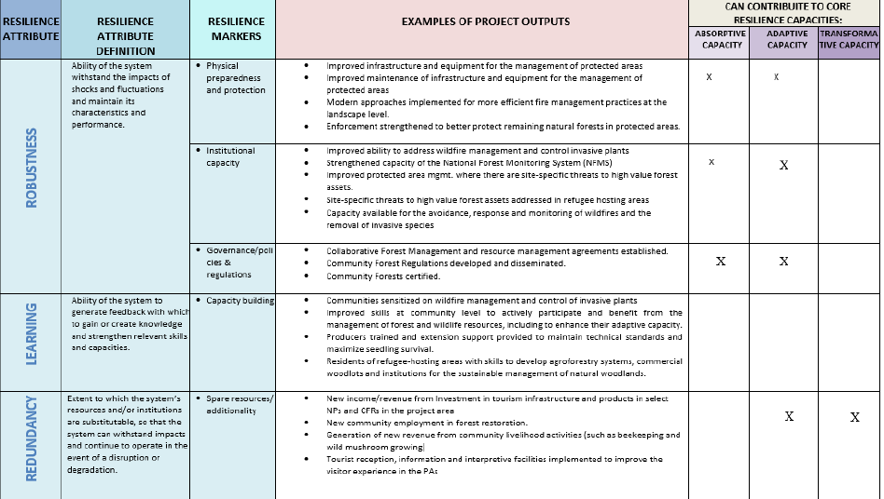

Slide 10
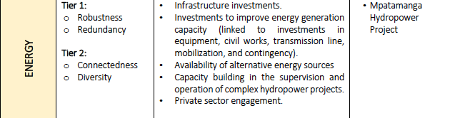
Example of Resilience Attributes per Sector

Slide 11
Inputs: Address the key resilience questions in order to inform the project’s design
Resilience where?
Project’s geographic setting where the project will take place.
Resilience to what?
Short term shocks and/or long-term stressors that the project will address.
Resilience of whom?
Project’s target groups / main beneficiaries.
Resilience for what purpose?
Development or other goal that the project seeks to achieve by building resilience.
Resilience how?
Description of the core resilience capacities (absorptive, adaptive and/or transformative) that the project will help to strengthen.

Slide 12
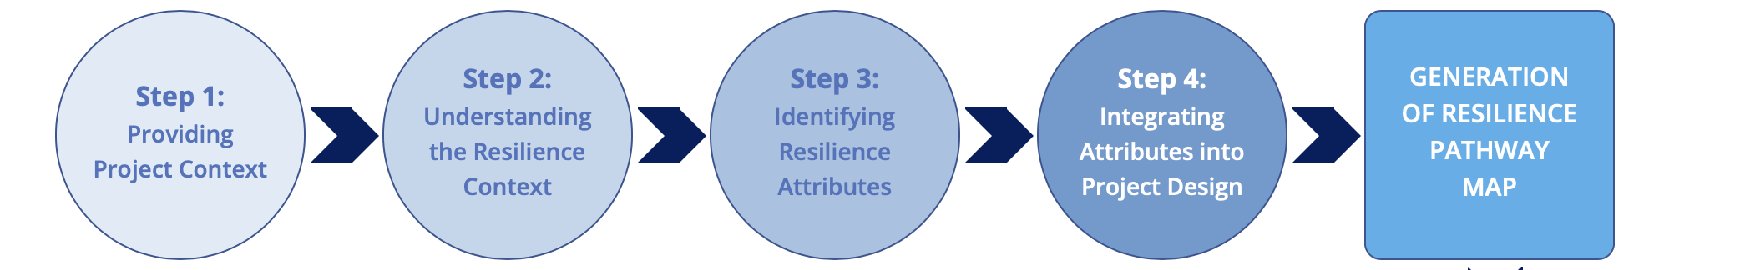
Four Distinct, Interrelated Steps
Optional step (Step 5) to complement the project’s M&E system by using resilience attributes to monitor resilience progress

Slide 13
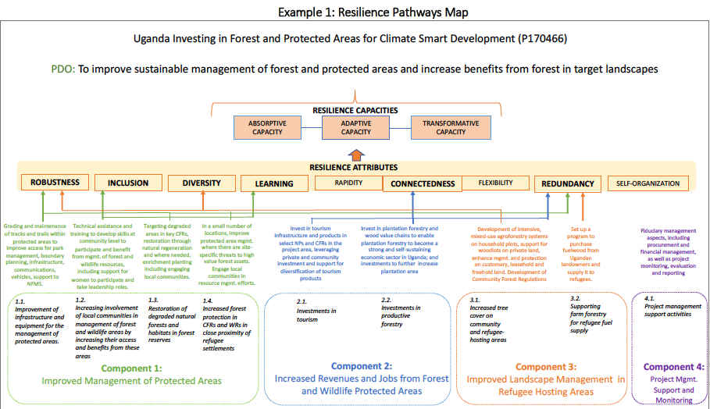

Slide 14
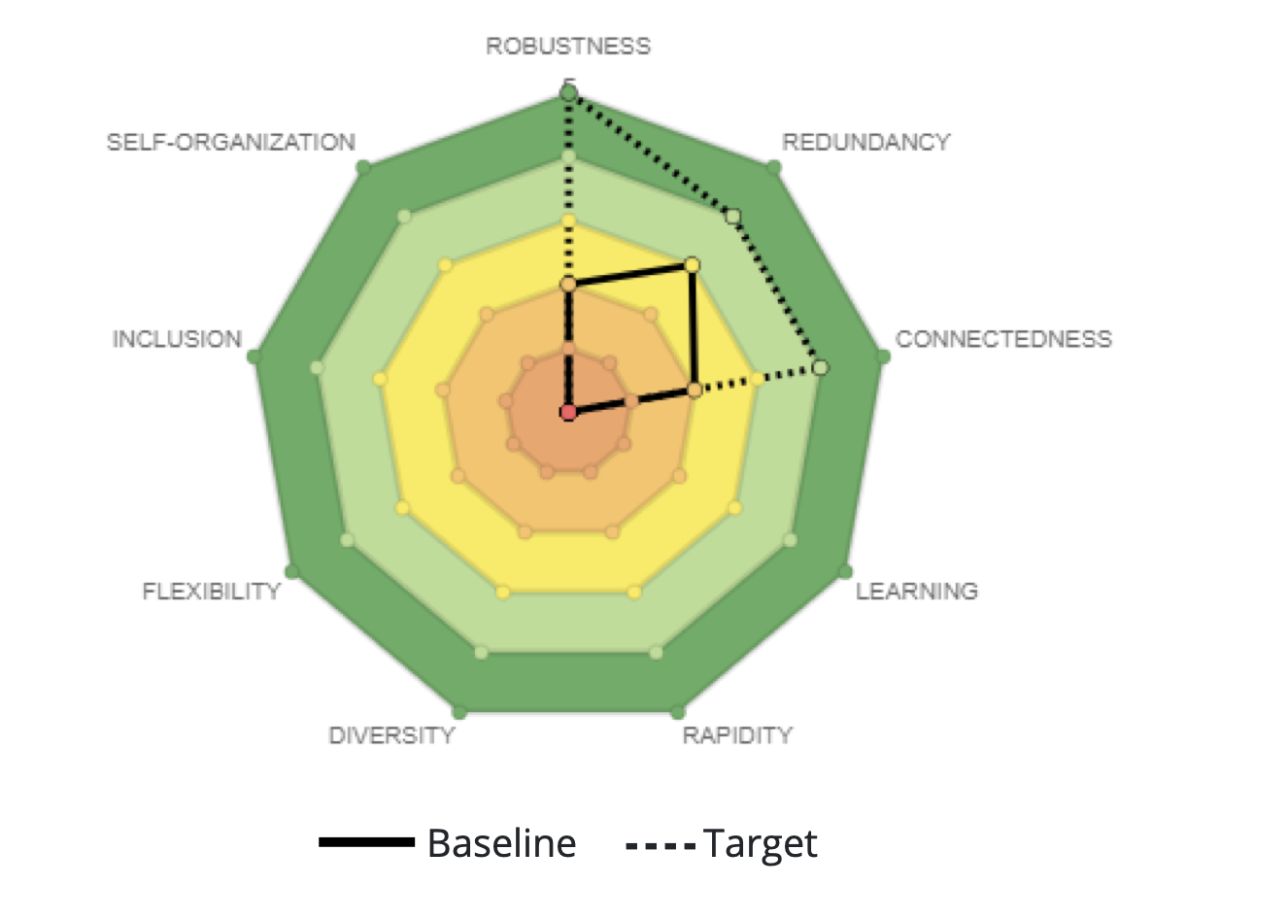
Resilience Attributes Baselines and Targets
This visualization shows the project’s resilience attributes baselines and targets.
The scores (low from 0-1, medium 2-3, high 4-5) can inform or complement the project’s Monitoring and Evaluation system.

Slide 15
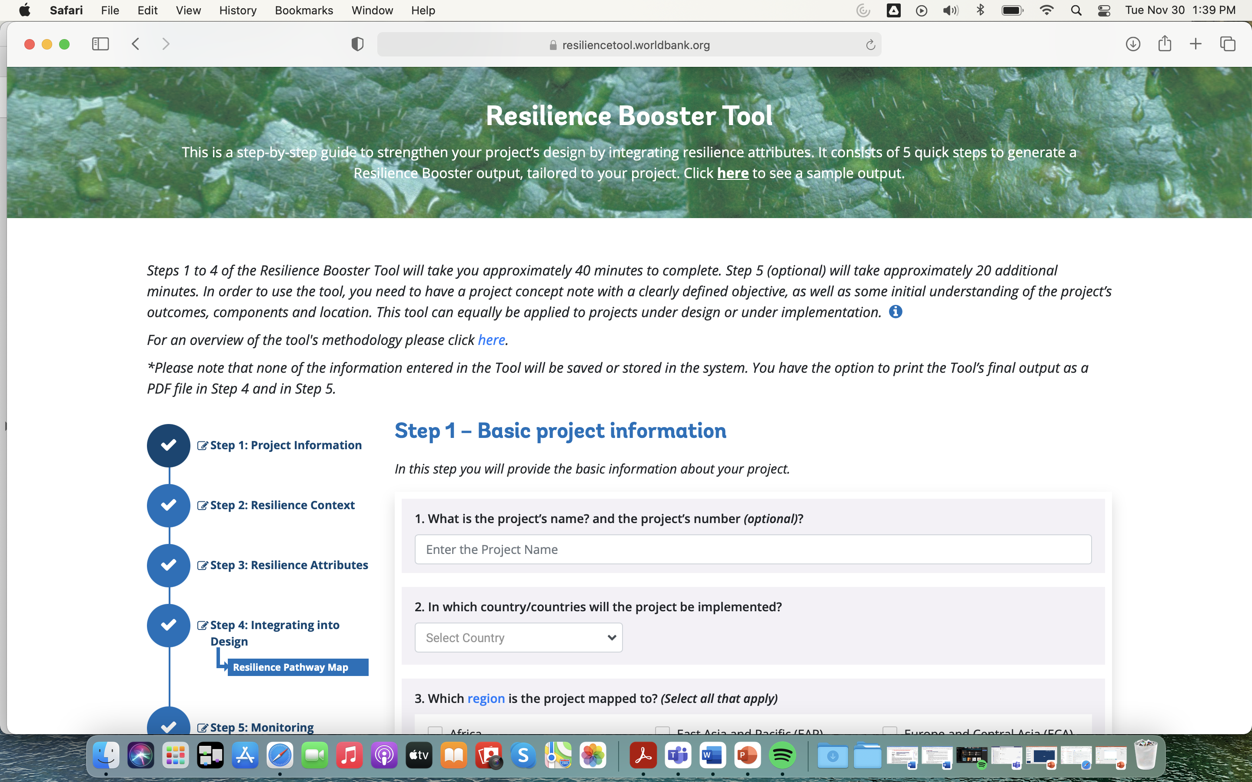
Notes:
https://resiliencetool.worldbank.org/#/home

