Slide 1
The Africa Climate Resilient Investment Facility (AFRI-RES) PIDA PAP II Training Programme Module 3: Integration of climate resilience guidelines for roads into project implementation

Slide 2
Structure of the Module
Aims of the Module
Setting expectations and scope for climate resilience
Assessing climate risk and vulnerability for roads
Adaptation Measures and options to increase climate resilience of roads projects
Nature-based Solutions and Case Study
Recommendations

Slide 3
Aims of AFRI-RES & the Training Programme
The Africa Climate Resilient Investment Facility (AFRI-RES) Objective: Strengthen the capacity of African institutions (national governments, river basin organizations, Regional Economic Communities, power pools and development practitioners) to plan, design, and implement investments resilient to climate variability and change in selected sectors
Training Programme Objectives
are well informed of climate risks to Africa’s infrastructure
understand climate resilience and its attributes and guidelines
are trained on the use of the resilience attributes and climate resilient guidelines for roads sector already developed through the World Bank under the AFRI-RES programme
can monitor and evaluate projects for adopting climate resilience attributes to ensure intended impacts of the projects
promote climate resilient measures to improve the quality and sustainability of projects
increase capacity on adaptive management of projects to integrate new information and knowledge on climate resilience relevant for the projects

Slide 4
Aims of Module 3
Upon the completion of Module 3, participants will
understand climate resilience and its attributes and guidelines
promote climate resilient measures to improve the quality and sustainability of projects

Slide 5
Setting Expectations and Scope
Adapting infrastructure planning and design ex ante has great potential to reduce climate change impacts on infrastructure in drier futures, and to take better advantage of higher water availability in wetter futures (WB, ECRAI)
What could be influenced by climate change?
Disruption of the Africa road network and economic costs
Increased maintenance costs
Shorter life span of roads and bridges
Destruction of segments of roads and bridges
Implications for food security
What should climate resilient measures address?
What variables should be considered?
What information and guidance will be provided by the government?

Slide 6
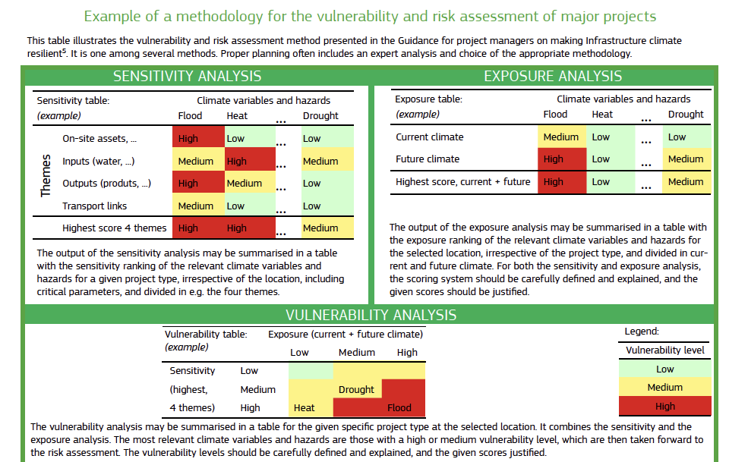

Slide 7
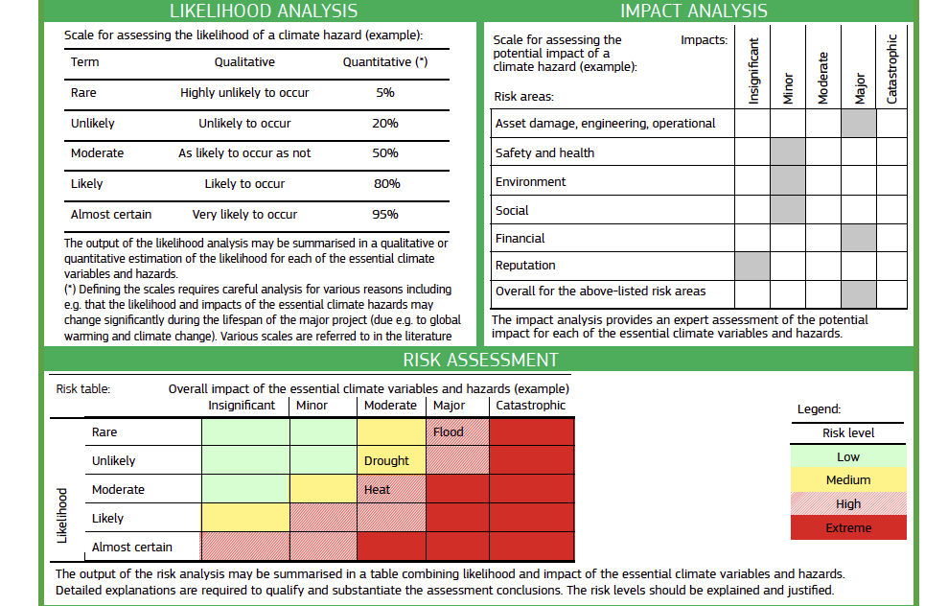

Slide 8
Source: European Commission, Climate Change and Major Projects: Outline of the climate change related requirements and guidance for major projects in the 2014-2020 programming period

Slide 10
What is needed to integrate climate change into road project design?
A set of downscaled climate projections for the project’s or country’s relevant geographic region.
Information on the baseline capital and maintenance costs for constructing roads to alternative design specifications.
A simple project design and cost model that can reproduce existing cost estimates from prefeasibility studies and can estimate how costs would vary with alternative design specifications that incorporate adaptation. If the complexity of the design precludes the development of a simple design and cost model, several estimates of alternative designs could be developed using more detailed tools.

Slide 11
Proactive Adaptation measures – Paved Roads
Climatic Variable | Impacts | Potential Resilience/Adaptation Measures
Temperature | Increased temperature leads to accelerated aging of binder | Construct dense seals (e.g. Sand Seal, Otta Seal, Cape Seal)
 | Increased temperature leads to rutting (of asphalt) and bleeding and flushing (of seals) | Adoption of base bitumen binders with higher softening points for surface seals and asphalts
Notes:
Source: Raffaello Cervigni, Andrew Losos, Paul Chinowsky, and James E. Neumann. Enhancing the Climate Resilience of Africa’s Infrastructure: The Roads and Bridge Sector. Africa Development Forum series. Washington, DC: World Bank. doi: 10.1596/978-1-4648-0466-3. License: Creative Commons Attribution CC BY 3.0 IGO

Slide 12
Proactive Adaptation Measures – Paved Roads
Climatic Variable | Impacts | Potential Resilience/Adaptation Measures
Precipitation & Flooding | Increased precipitation leads to increased average moisture content in subgrade layers and reduced load carrying capacity | Add wider paved shoulders to improve surface drainage. Increase base strength (thickness and/or quality) to increase protection of subgrade layers.
 | Washaways and overtopping of road | Increase flood design return period by increasing the size of culverts (in most cases will require raising the road to allow larger culvert to fit).
Notes:
Source: Raffaello Cervigni, Andrew Losos, Paul Chinowsky, and James E. Neumann. Enhancing the Climate Resilience of Africa’s Infrastructure: The Roads and Bridge Sector. Africa Development Forum series. Washington, DC: World Bank. doi: 10.1596/978-1-4648-0466-3. License: Creative Commons Attribution CC BY 3.0 IGO

Slide 13
Proactive Adaptation Measures – Unpaved Roads
Climatic Variable | Impacts | Potential Resilience/Adaptation Measures
Precipitation and flooding | Increased precipitation leads to increased average moisture content in subgrade layers, and reduced loadcarrying capacity | Increase gravel wearing course thickness to increase cover and protect subgrade layers.
 |  | Upgrade road to paved.
 | Washaways and overtopping of road | Increase flood design return period by increasing the size of culverts (in most cases will require raising the road to allow the culvert to fit underneath).
Notes:
Source: Raffaello Cervigni, Andrew Losos, Paul Chinowsky, and James E. Neumann. Enhancing the Climate Resilience of Africa’s Infrastructure: The Roads and Bridge Sector. Africa Development Forum series. Washington, DC: World Bank. doi: 10.1596/978-1-4648-0466-3. License: Creative Commons Attribution CC BY 3.0 IGO

Slide 14
Nature-based Solutions
What are Nature-based Solutions for Adaptation and Resilience?
Nature-based Solutions (NBS) are activities associated with the protection, management, enhancement, and restoration of nature to deliver climate resilient infrastructure
NBS can be used to safeguard traditional gray infrastructure while delivering enhanced resilience and co-benefits (e.g. climate change mitigation, supporting biodiversity and local livelihoods, food and water security)
Why choose NBS as an adaptation measure?
Ensures the sustainability of the infrastructure
Protects from hazards
Secures access to basic services & livelihoods

Slide 15
Nature-based Solutions and Roads: Case Study from Haiti
Problem to be addressed: Heavy rainfall, floods and landslides destroyed road systems making certain areas in the island inaccessible and resulting in costly repairs and maintenance.
Source: AAE, Nature-based Solutions for resilient roads infrastructure in Haiti

Slide 16
Policy Recommendations
Incorporate Climate Change in Road Asset Management. With a focus on institutionalizing regular road management and funding for maintenance that integrates climate resiliency into road asset management.
Engineering Design solutions for effective long-term resilience. Investing
proactively in pavement improvements to withstand increased temperature is economically justified under most climate projections, even without taking into account the cost of increased disruption time. Proactive adaptation to precipitation and flooding events is more expensive and better justified when taking into account disruption of traffic volume and economic links
Nature-based Solutions or Hybrid Solutions could offer cost effective adaptation measures for flooding, especially when taking into account co-benefits.

Slide 17
Specific PIDA Recommendations
PIDA road transport projects could include in the design stage provisions to include high temperature seals in the construction of the roads
Evaluate the optimal timing for precipitation and flooding adaptations actions for the PIDA projects.
Require that project developers carry out climate risk evaluations for road and bridge projects. Follow-up using individual scenarios for climate projections, and more detailed engineering for project level analyses.
Identify critical road networks in existing system, including bridges, and establish priority status for climate risk and financial analyses for those infrastructure segments.
Identify existing weather sensitive hotspots in the transport system – roads and bridges – and look across climate forecasts to identify trends of concern in temperature, precipitation, flooding, and river runoff scour or overtopping. Update construction norms to account for these factors.
Mainstream vulnerability assessment into a range of road infrastructure project types.

Slide 18
Breakout Groups by Hazard
Heat
Heavy Rain
Flooding
Any action already being taken to address this hazard?
What types of actions could be implemented now on the PIDA project?

Slide 19
Resources
World Bank, Enhanced Climate Resilience of Africa’s Infrastructure
Raffaello Cervigni, Andrew Losos, Paul Chinowsky, and James E. Neumann. Enhancing the Climate Resilience of Africa’s Infrastructure: The Roads and Bridge Sector. Africa Development Forum series. Washington, DC: World Bank. doi: 10.1596/978-1-4648-0466-3. License: Creative Commons Attribution CC BY 3.0 IGO
European Commission, Climate Change and Major Projects: Outline of the climate change related requirements and guidance for major projects in the 2014-2020 programming period
AAE, Nature-based Solutions for resilient roads infrastructure in Haiti
Asian Development Bank. Guidelines for climate proofing investment in the transport sector: Road infrastructure projects.
Mandaluyong City, Philippines: Asian Development Bank, 2011.

