Slide 1
The Africa Climate Resilient Investment Facility (AFRI-RES) PIDA PAP II Training Programme Module 1: Climate Risks, Impacts and Vulnerability for Road Projects

Slide 2
Structure of the Module
Aims of the Module
Climate Change Outlook globally
Climate Risks for Africa in medium and long term
Exercise: Using the IPCC Interactive Atlas
Expected Climate Impacts on Roads
Why Adapt?
Discussion
Glossary and Resources

Slide 3
Aims of AFRI-RES & the Training Programme
The Africa Climate Resilient Investment Facility (AFRI-RES) Objective: Strengthen the capacity of African institutions (national governments, river basin organizations, Regional Economic Communities, power pools and development practitioners) to plan, design, and implement investments resilient to climate variability and change in selected sectors
Training Programme Objectives
are well informed of climate risks to Africa’s infrastructure
understand climate resilience and its attributes and guidelines
are trained on the use of the resilience attributes and climate resilient guidelines for roads and the transport sector already developed through the World Bank under the AFRI-RES programme
can monitor and evaluate projects for adopting climate resilience attributes to ensure intended impacts of the projects
promote climate resilient measures to improve the quality and sustainability of projects
increase capacity on adaptive management of projects to integrate new information and knowledge on climate resilience relevant for the projects

Slide 4
Aims of Module 1
Upon the completion of Module 1, participants will have an increased understanding of climate risks and impacts for the road projects in PIDA PAP II in order to utilize this information in the oversight of implementation and the monitoring and evaluation of PIDA PAP II projects.

Slide 5
Climate Change Outlook Globally
The recently released 6th Assessment Report from the Intergovernmental Panel on Climate Change (IPCC) Working Group 1 shows that emissions of greenhouse gases from human activities are responsible for approximately 1.1°C of warming since 1850-1900, and finds that averaged over the next 20 years, global temperature is expected to reach or exceed 1.5°C of warming
For the future outlook, there are different scenarios based on the extent to which mitigation of emissions is undertaken and Shared Socio-economic Pathways (SSPs) that incorporate variations in human, economic and social development
There are also different scenarios for the future including variation in mitigation of emissions and socio-economic pathways.
Notes:
More information on SSPs (https://www.carbonbrief.org/explainer-how-shared-socioeconomic-pathways-explore-future-climate-change)

Slide 6
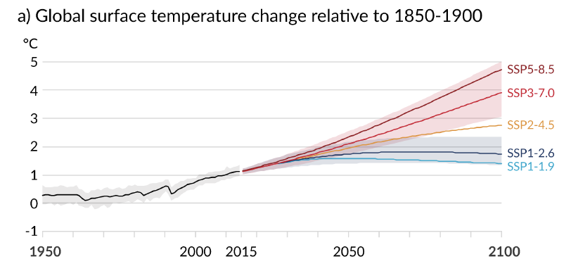
Every tonne of CO2 emissions adds to global warming
As a result, there is still a range of scenarios for the level of warming by the end of the century
Source: IPCC 6th Assessment, WGI Report

Slide 7
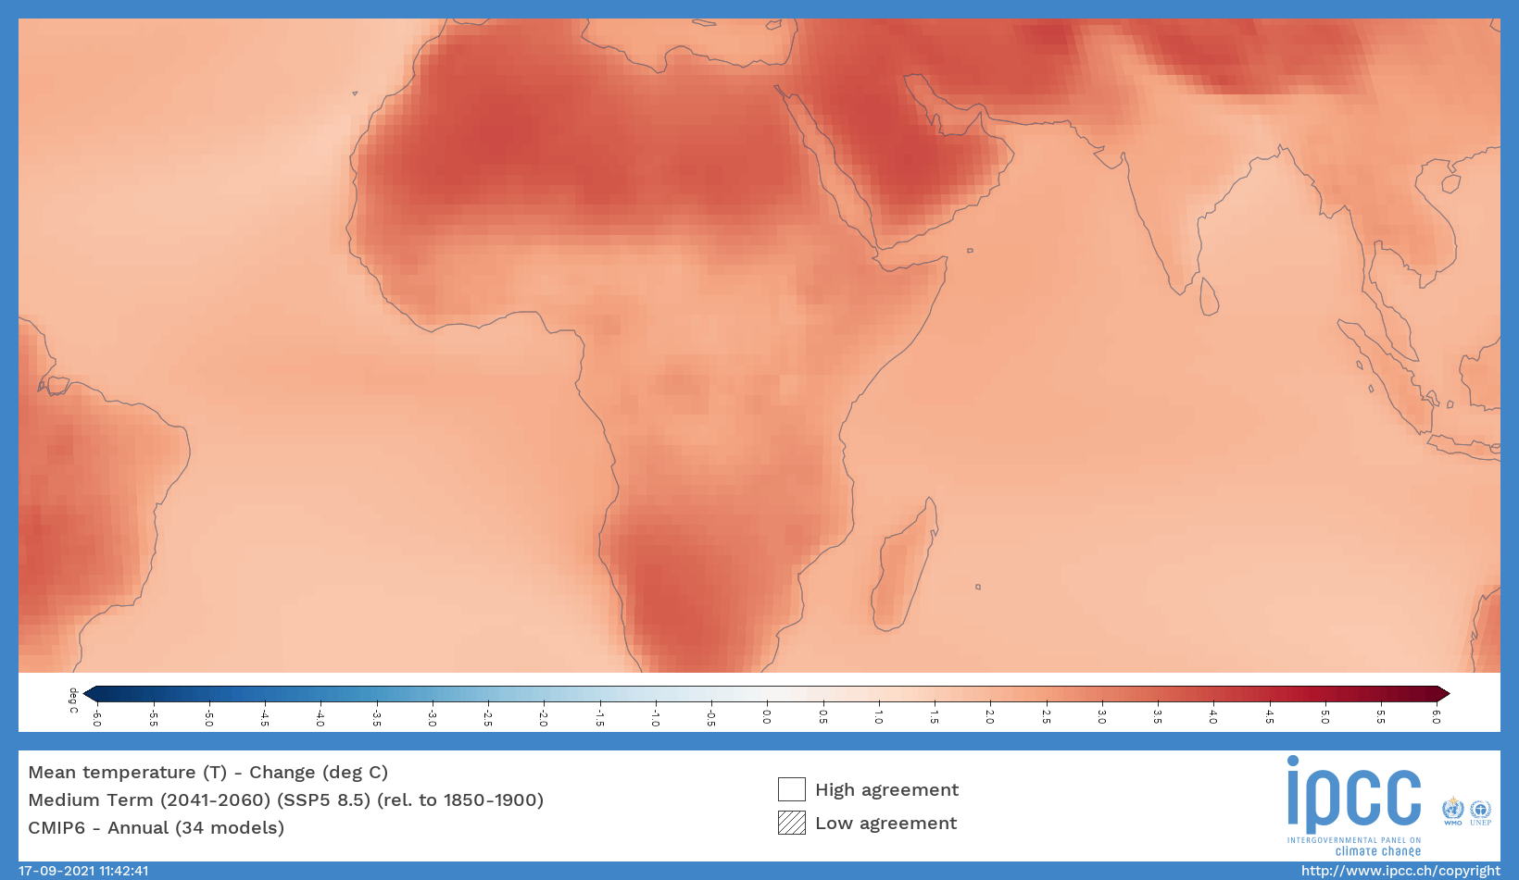
Climate Change in Africa
Notes:
https://interactive-atlas.ipcc.ch/permalink/XgwlTOwC

Slide 8
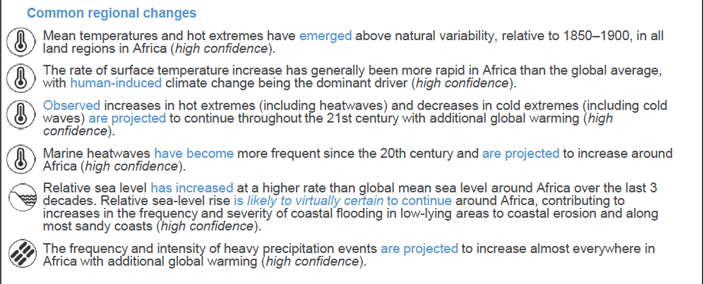
Climate Change in Africa
Source: IPCC 6th Assessment, WGI Report, Africa Factsheet

Slide 9
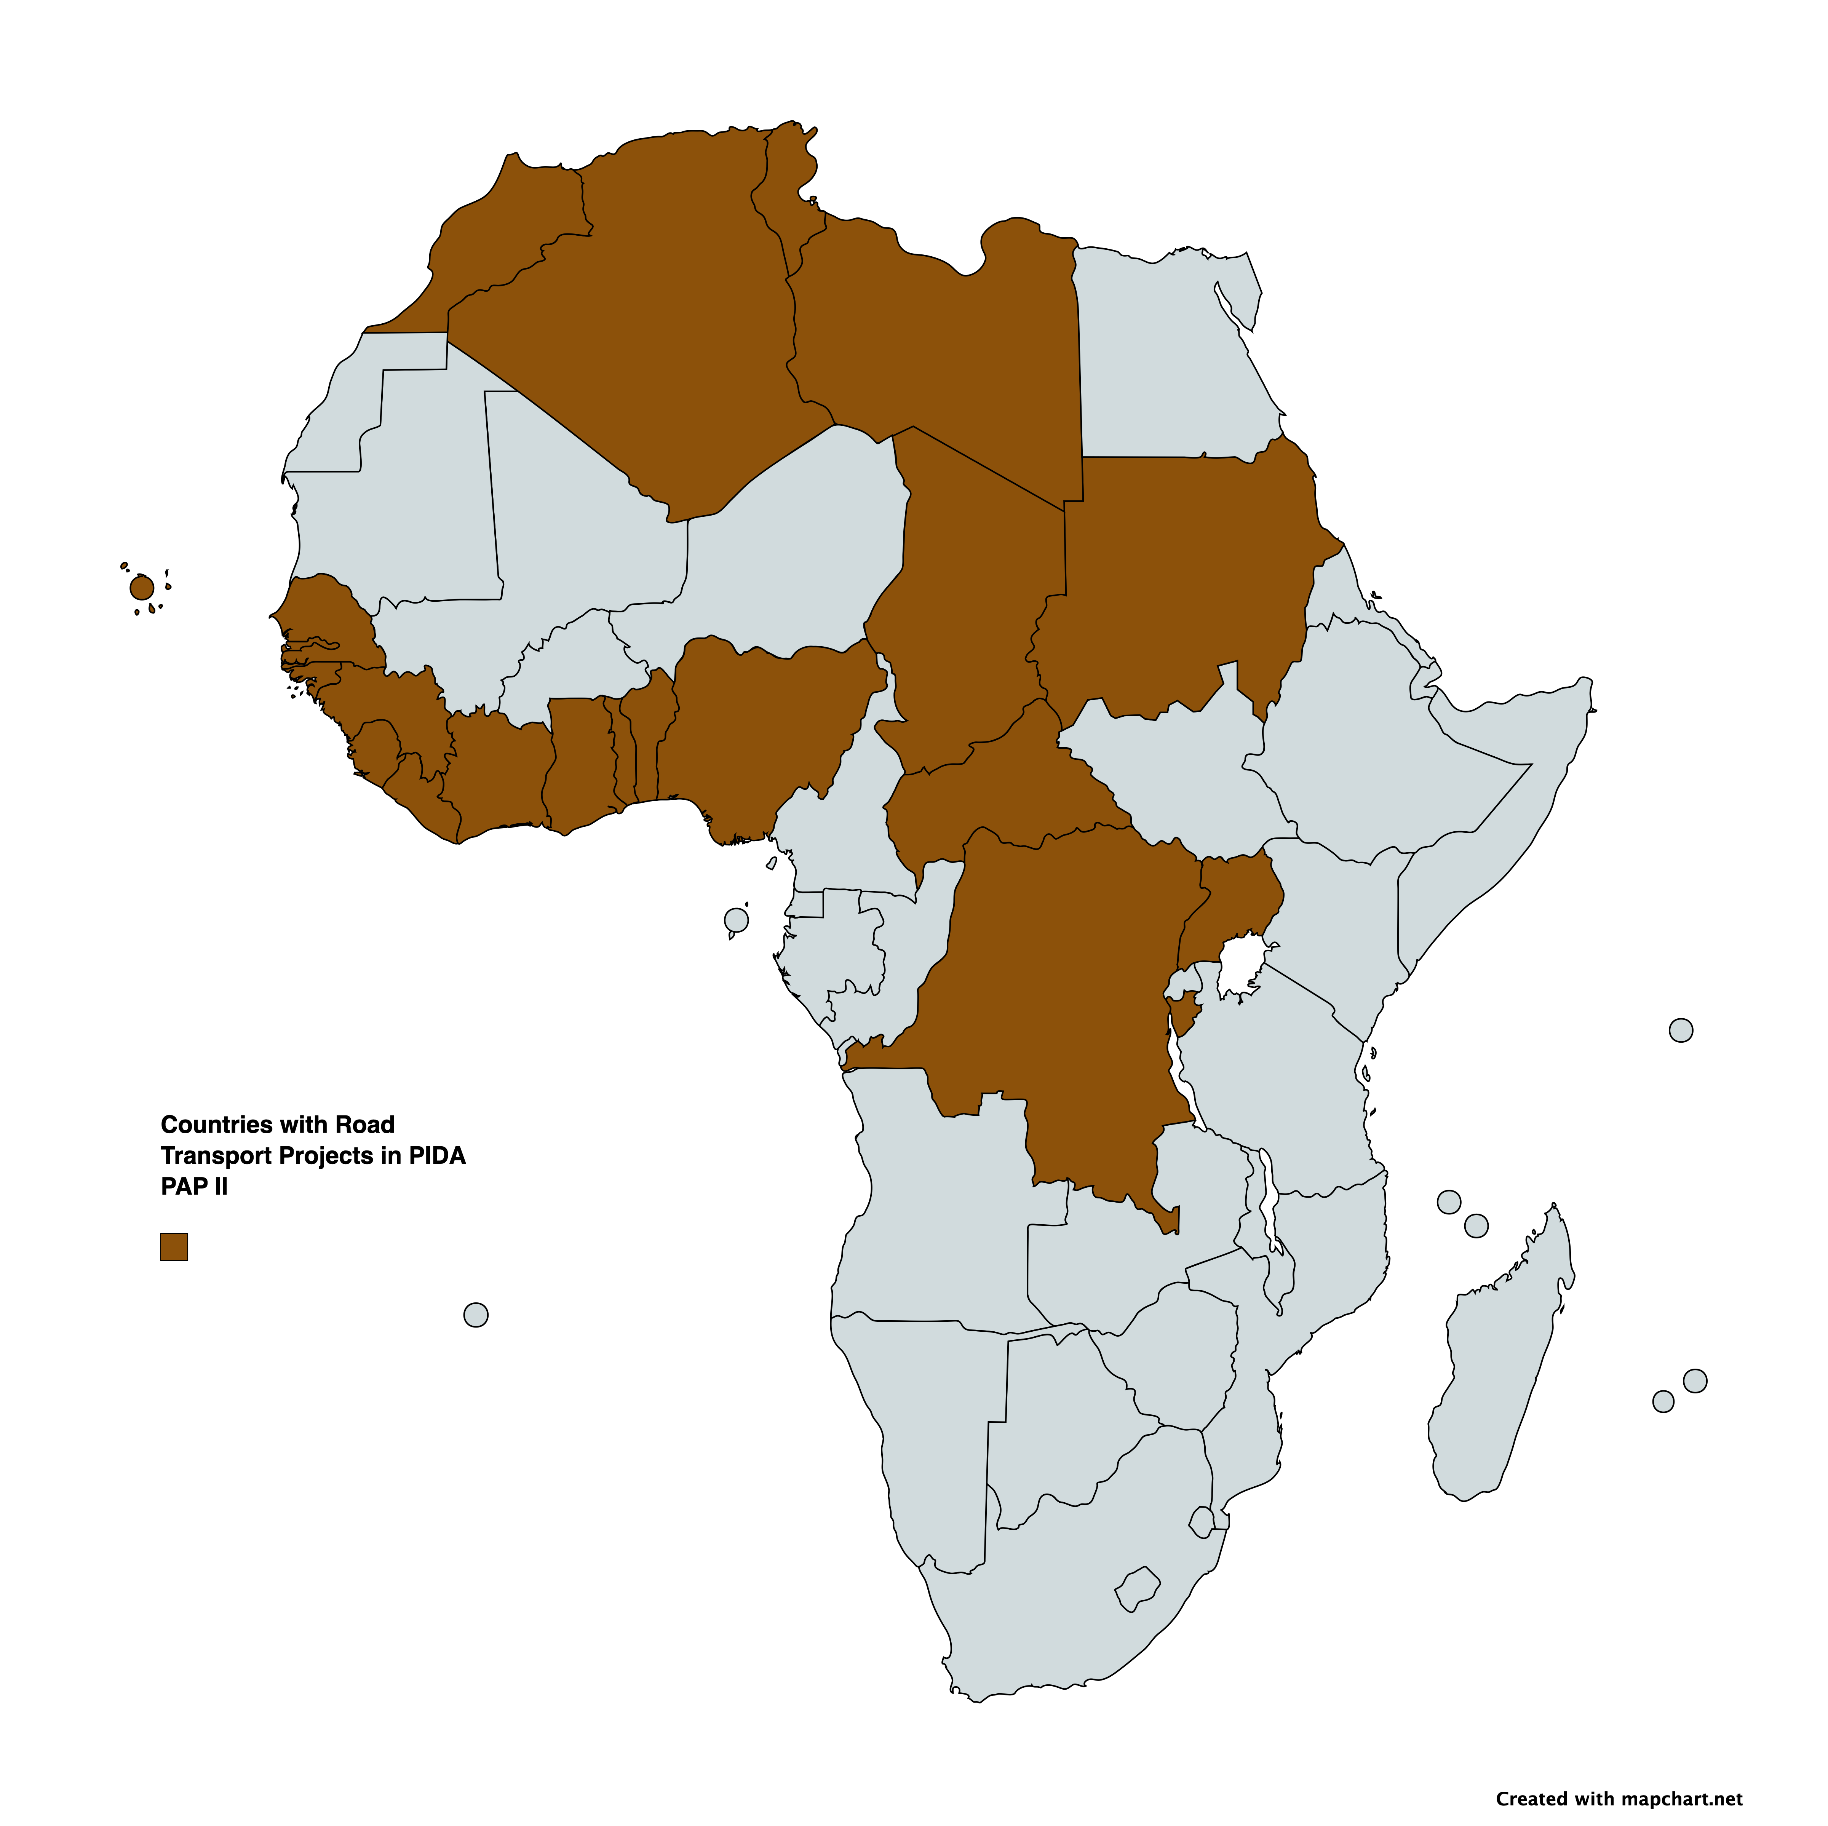

Slide 10
Observed and projected changes in regions with road projects
West Africa (WAF)
Observed increase in river flooding;
Observed increase in drying and agricultural and ecological droughts;
Projected increase in meteorological droughts at GWL 4°, mostly in seasonal timescales;
Projected increases in mean wind speed; increase in heavy precipitation and pluvial flooding.
Central Africa (CAF)
Observed decreases in mean precipitation;
Observed decrease in standardized precipitation index (i.e deficit of precipitation);
Observed increase in agricultural and ecological droughts;
Projected increases in heavy precipitation and pluvial flooding; increases in river flooding.
Mediterranean (North Africa)
Projected decreases in mean precipitation, increases in fire weather conditions and decreases in mean wind speed;
Observed and projected increases in aridity, meteorological, hydrological and agricultural and ecological droughts.
Sahara including parts of the Sahel (SAH)
• Projected increases in heavy precipitation and pluvial flooding.
Source: IPCC 6th Assessment, WGI Report, Africa Factsheet

Slide 11
IPCC Working Group 1: Interactive Atlas Activity
The atlas can be found here: https://interactive-atlas.ipcc.ch/permalink/XgwlTOwC
Step 1: Zoom into your region or country
Step 2: Select with Models- Historical and Projections that you want to utilize
Step 3: Decide which variable you are interested in (Mean Temperature, Total Precipitation, Consecutive Dry Days, etc)
Step 4: Select which period you want to cover (near term, medium term, long term)
Step 5: Select which emissions scenario (SSP5 – 8.5 is high; SSP2 – 4.5 is medium; SSP1 – 2 is low)
Step 6: Generate map
Optional: Change some of the selections above and generate a different map

Slide 12
Vulnerability to Climate Change
Vulnerability stems from the sensitivity and limited adaptive capacity of a power system and the stakeholders involved in the system.
 | Sensitivity | Adaptive Capacity
Definition | The extent to which a system is impacted by a sector or a source that could be negatively affected by climate hazards | Refers to the ability of a system and stakeholders to anticipate, prepare for and plan in advance to cope with potential climate impacts.
African Transport Sector | Increased heat and precipitation events damage paved and unpaved roads causing disruptions | Public officials and technical experts in the majority of African countries, particularly those in rural areas, have low levels of adaptive capacity; some of them are already experiencing difficulties in coping with the current level of climate variability (IPCC, 2014a).

Slide 13
Climate Impacts on Roads and Transport Sector in Africa
Roads are particularly vulnerable to climate risks such as increased temperature and precipitation and flooding.
Increased temperature leads to accelerated aging of the pavement binder and rutting of asphalt on paved roads.
Increased precipitation and flooding lead to reduced load-carrying capacity and overtopping of roads on paved and gravel roads.
Increased maintenance and a potentially shorter life between rehabilitation cycles
Indirect effects include disruption of unimpeded travel of people and goods, either because the road surface is damaged or destroyed, or because it is in the process of being repaired. These disruptions in turn affect economic activity and productivity.
Source: World Bank ECRAI Transport

Slide 14
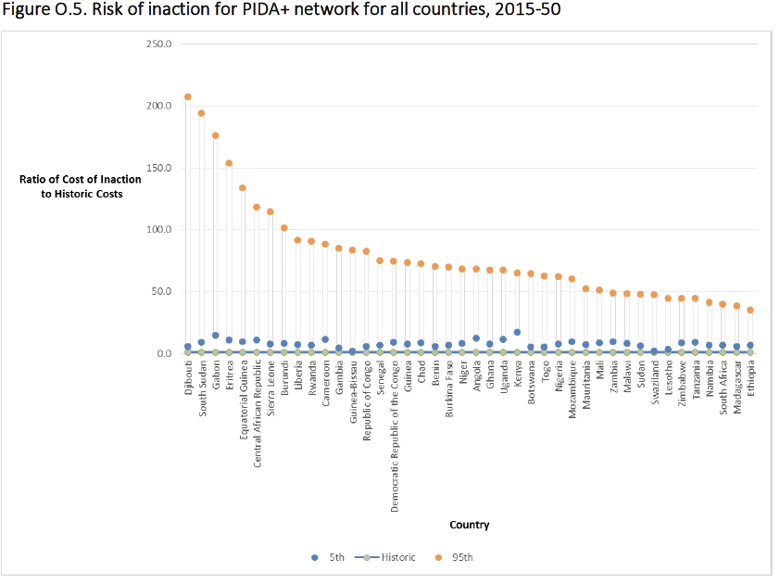
Source: World Bank ECRAI Transport
Notes:
The chart provides an indication of the impact of climate change relative to the optimal maintenance for a
historic climate (because actual road maintenance is typically underfunded relative to the optimal maintenance cost,
impacts are likely to be higher than indicated). The blue line shows the country-specific historic (no-climate-change)
costs. Blue dot shows the 5th percentile (most benign) of costs over climate change scenarios; orange dot shows the
result for the 95th percentile (most damaging) of costs.

Slide 15
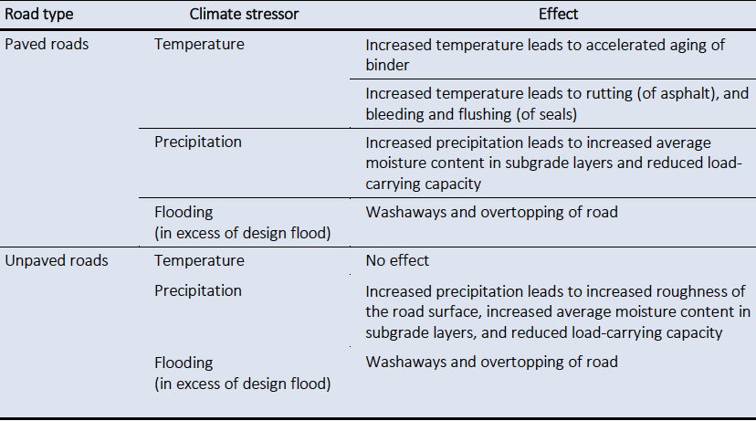
Source: World Bank ECRAI Transport

Slide 16
Why Adapt
In the period from the present to 2050, climate change could cause:
Direct damages: tens of billions of dollars in damages to roads, which will require additional maintenance to preserve basic serviceability; preliminary estimation of damage to bridges suggests costs may be even higher (in the order of $30 billion, mean estimate).
Substantial system disruption: apart from increasing maintenance costs, climate changes will cause the disruption of road links, interrupting the flow of goods and people, to the tune of 100 million days of disrupted road links by 2050, all of which has a substantial economic cost.
Engineering solutions can be effective in addressing some impacts of climate change, through proactive action, depending on the context.
These solutions can provide long-term resilience, with less disruption and lower lifetime maintenance costs, in exchange for a higher up-front investment.

Slide 17
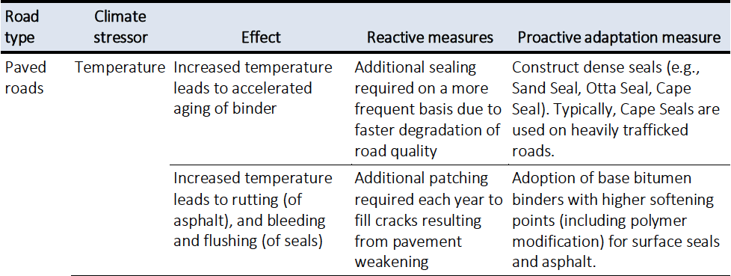
Why Adapt: Proactive vs Reactive responses to climate impacts on roads
Source: World Bank ECRAI Transport

Slide 18
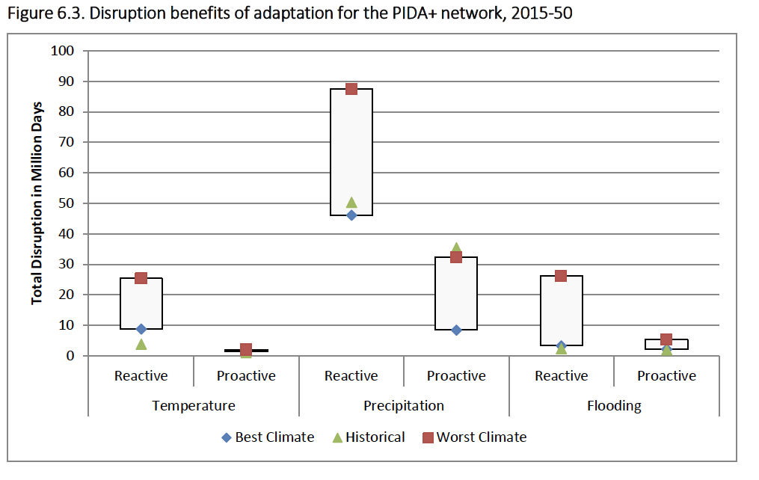
Source: World Bank ECRAI Transport
Notes:
Figure 6.3 shows
the total disruption days under the reactive and proactive approaches for the three stressors. As
shown, the reactive response approach results in greater disruption than proactive adaptation.
Because this cumulative physical effects measure is difficult to reliably monetize, the key question
is therefore whether savings in maintenance costs, plus avoided disruption, is sufficient to justify
a proactive adaptation approach for roads; this is discussed in the next section.
The blue and red data points refer to the disruption time under the mildest/ best climate scenario, and the
strongest/ worst climate scenarios, respectively. Green triangle shows result for historic climate.

Slide 19
Case Study Example: Resilience Solutions for the Road Sector in South Africa
The potential impact of climate change in terms of additional annual costs on South Africa’s national road network may be as high as USD 96 million in 2030, USD 229 million in 2050, and USD 390 million in 2090, if no adaptation measures are taken.
Challenge identified: Allocated budgets are insufficient to keep ahead of the desired quality of maintenance and replacement curve. Government
infrastructure procurement is also notoriously difficult to innovate.
Potential Solutions: a funding model whereby local and national governments could access upfront finance for resilience interventions. The need to
spend more now to save later, is counterintuitive to budget-constrained
Administrations.
A green bond, a beneficial trade agreement or another instrument to achieve this investment in upfront costs.
Source: Inter-American Development Bank (2020) Factsheet Resilience Solutions for the Road Sector in South Africa

Slide 20
Discussion Topics
What are impacts of climate change that you are experiencing in your country?
What data and knowledge gaps are there that limit the capacity to assess climate impacts?
Which impacts are you most concerned will affect road construction, maintenance and longevity in your country or region?
What do you see as the main costs of adapting road projects to climate change? What would be the costs of inaction?

Slide 21
Glossary
Resilience is defined by the Intergovernmental Panel on Climate Change (IPCC) as the capacity of social, economic and environmental systems to cope with a hazardous event or trend or disturbance, responding or reorganizing in ways that maintain their essential function, identity and the capacity for adaptation, learning and transformation.
Climate risk indicates the factors which are associated with the potential
consequences of climate change. According to the Intergovernmental Panel on
Climate Change (IPCC), it results from the interaction of hazard, exposure and
vulnerability (IPCC, 2014a).
Hazard refers to the potential occurrence of physical impact from changes in long-term climate trends or extreme weather events. For instance, if a country is projected to experience an increased frequency of intense climate-related events, the level of hazard will increase.

Slide 22
Exposure indicates the presence of assets, services, resources and infrastructure that could be adversely affected. For instance, if a power system has most of its grids located in a coastal area, it can be considered more exposed to climate risks of sea-level rise or coastal flooding than a system located further inland
Vulnerability is the propensity or predisposition to be adversely affected. It includes sensitivity to climate change impacts and lack of adaptive capacity which refers to the ability of a system to anticipate, prepare for and plan effectively for climate change. (DFID, 2011). If a power system is well equipped with a robust data system and capable human resources to anticipate and adapt to climate change impacts, the system can be considered less vulnerable.

Slide 23
Resources
IPCC (2021), Sixth Assessment Report, Working Group I
World Bank, Enhanced Climate Resilience of Africa’s Infrastructure
Raffaello Cervigni, Andrew Losos, Paul Chinowsky, and James E. Neumann. Enhancing the Climate Resilience of Africa’s Infrastructure: The Roads and Bridge Sector. Africa Development Forum series. Washington, DC: World Bank. doi: 10.1596/978-1-4648-0466-3. License: Creative Commons Attribution CC BY 3.0 IGO

