Slide 1
The Africa Climate Resilient Investment Facility (AFRI-RES) PIDA PAP II Training Programme Module 4: Monitoring and Evaluation of climate resilient measures for Hydropower & Roads
Short, medium and long term and how to integrate adaptive management if needed

Slide 2
Structure of the Module
Aims of the Module
Developing Monitoring and Evaluation Plans
Integrating Adaptive Management
Hydropower Resilience Monitoring Case Study
Adaptation Monitoring Best Practices

Slide 3
Aims of AFRI-RES & the Training Programme
The Africa Climate Resilient Investment Facility (AFRI-RES) Objective: Strengthen the capacity of African institutions (national governments, river basin organizations, Regional Economic Communities, power pools and development practitioners) to plan, design, and implement investments resilient to climate variability and change in selected sectors
Training Programme Objectives
are well informed of climate risks to Africa’s infrastructure
understand climate resilience and its attributes and guidelines
are trained on the use of the resilience attributes and climate resilient guidelines for hydropower & roads’ sector already developed through the World Bank under the AFRI-RES programme
can monitor and evaluate projects for adopting climate resilience attributes to ensure intended impacts of the projects
promote climate resilient measures to improve the quality and sustainability of projects
increase capacity on adaptive management of projects to integrate new information and knowledge on climate resilience relevant for the projects

Slide 4
Aims of Module 4
Upon the completion of Module 4, participants will have an increased understanding of monitoring and evaluating projects and increasing capacity for adaptive management of climate resilience for hydropower & roads’ projects in PIDA PAP II.
Notes:
Whereas planning of infrastructure at the river basin and national scale is important for broad long-term
investment plans, the individual schemes are ultimately designed based on financial and economic
analyses of the project-specific costs and benefits. The need for planning long-lived infrastructure
projects by taking into account climate change has been often highlighted been in recent times. Much
emphasis has been put into understanding the ensemble of future possible climate scenarios and how
these would affect the performance of hydropower or irrigation projects. However, when attempting to
utilize the complex information on climate futures to adapt the detailed design of such infrastructure
there has been a ‘culture clash’ between climate scientists and engineers. One reason is that, in its level
of detail, the design of a large water infrastructure project is equally, or even more, complex than the
climate scenarios, considering the variety of technical aspects involved (e.g. geotechnical, hydraulic,
mechanical, environmental, and social). Because of its unique dependency on site-specific
characteristics and typically high demand for reliability in water delivery (e.g. power and water supply),
large infrastructure project design is seldom based solely on financial or economic considerations, but
on a combination of conservative safety margins, practical constraints for construction and economic
performance. The introduction of climate change uncertainty into this project design paradigm creates
challenges, which are often underestimated by both the climate scientists and the design engineers.
The work presented in this chapter is an attempt to address the challenges of incorporating climate
science into project design.

Slide 5
Why Monitoring and Evaluation is critical for climate resilient infrastructure
Monitoring, Evaluation and Reporting to track how resilient the project is in operation and integrate adaptive management that responds to new development and information related to climate change.
A further goal of establishing monitoring and evaluation frameworks is to ensure accountability and that lessons are learned to inform future adaptation efforts.
Integration with project Monitoring cycles
Integration with Environmental and Social Management
Building on climate risk and vulnerability assessment

Slide 6
Challenges to monitoring adaptation
Long-term nature of climate change impacts
Need to acquire appropriate baseline data and metrics for measuring vulnerability
Isolating vulnerability to climate change from other sources of pressure

Slide 7
Climate resilience monitoring
Questions to be considered in setting up monitoring for climate risk:
How resilience measures that help maintain the risk at an acceptable level will be monitored and reported, if any additional or new data collection or process needs to be set up?
How lessons learned from experienced climate and weather related events will be captured?
How will the monitoring and reporting information feed into the evaluation process for the project?
Who is responsible for monitoring, reporting and evaluating each action?
What is the dataset (type and acquisition frequency) that needs to be regularly collected for future climate risk assessments and to ensure that responsibilities are assigned and budgets available for their collection?
*Data covers hydro-meteorological parameters in the catchment, as well as natural hazards parameters. This may include data generated internally or acquired from external sources. The internal or external resources of equipment and facilities needed to acquire this data must be identified.
What local and regional authorities need to be engaged with monitoring and/or data collection?

Slide 8
Evaluation and reassessment of climate risks
It may be necessary to re-assess and update climate risk management plans.
Suggested triggers for a more in-depth reassessment may be:
Significant long-term changes to the climate change prospect or trends, such as new scientific evidence
New competing water users, regulatory changes that affect water use or availability, etc, that might or might not be climate-related.
A new and unexpected event or sequence of events that relate to climate or natural hazards (e.g. a major climatic event that may impact on initial assumptions).

Slide 9
Adaptive Management
Adaptive management is a flexible, iterative process for revisiting and improving adaptation practices based on monitoring and evaluation (M&E).
Adaptive management may include:
Monitoring the consequences of weather-related events on a specific hydropower asset or across the energy sector;
Monitoring changing demand for electricity given observed climate variability and change, changing demographics, and changing economic and social conditions;
Evaluating the adequacy of implemented adaptation measures; and
Monitoring local climate variations and observed changes
Integrating new climate information and future climate projections as they become available
Notes:
USAID (2017) Addressing Climate Vulnerability for Power System Resilience and Energy Security: A Focus on Hydropower Resources
Enhancing climate resilience of power systems and projects should be an ongoing process; adaptation measures take time and resources to implement, the climate continues to change, and scientific understanding of future climate change impacts evolves.

Slide 10
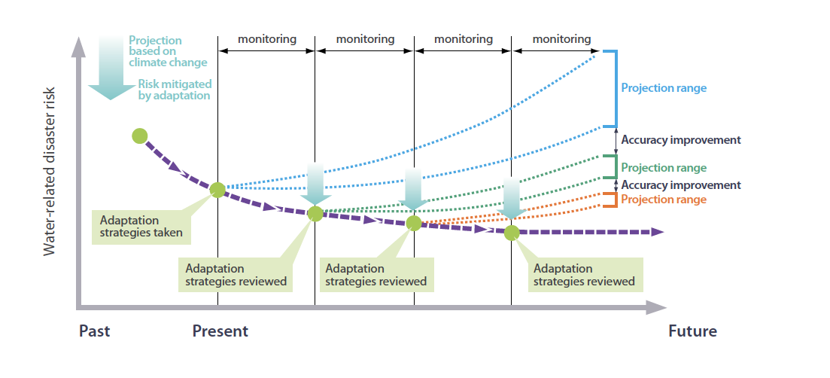
Adaptive Management
Source: International Hydropower Association, 2019. Hydropower Sector Climate Resilience Guide. London, United Kingdom
Notes:
Based on findings from M&E, project and power system managers can iteratively and strategically adjust operations (e.g., to flood risk management protocols) or undertake new adaptation measures accordingly, both at individual hydropower plants and/or across the power sector. While this type of M&E is still at a nascent stage (in part because implementation of adaptation measures to enhance hydropower resilience is relatively new), many hydropower sector practitioners are beginning to invest in this area by developing collaborative partnerships with research organizations and training staff to better understand climate diagnostics (IHA, 2015).

Slide 12
Example of Monitoring Plan on Climate Change related risks for Roads
Monitoring Parameters | Monitoring Indicator | Monitoring Location | Monitoring Method | Monitoring Frequency | Monitoring Responsibility | Monitoring Cost
Heat | Consecutive Number of days above 35 degrees | Paved Roads | Maintenance crews driving along road looking for disruptions
Precipitation | Flooding on road sites | Paved and unpaved roads | Establish early warning systems and rescue teams

Slide 13
Example of Monitoring Plan on Climate Change related risks for Hydropower
Monitoring Parameters | Monitoring Indicator | Monitoring Location | Monitoring Method | Monitoring Frequency | Monitoring Responsibility | Monitoring Cost
Landslides and erosion | Number of landslides/debris flows/gully formation sites marked and indicated in maps | Dam site, internal access roads, camps, storage facilities, etc | Direct observation and mapping in the appropriate scale map
Climate | Air temperature, rainfall and humidity | Dam site, Reservoir area | Establish weather station and arrange human capacity for daily observation
Adapted from Hydropower Environmental Impact Assessment Manual of the Government of Nepal

Slide 14
Climate Change Adaptation Monitoring and Evaluation Recommendations
Align the adaptation M&E system with existing systems and minimize duplication or additional features that overburden project leads and agencies
Indicator development should be well-planned, use a stepwise approach, and be initiated early in the planning process
Input to and ownership of M&E is needed across relevant sectors of government

Slide 15
Activity:
Developing Climate-related Monitoring Plan for PIDA PAP II Hydropower and Roads Projects
Monitoring Parameters | Monitoring Indicator | Monitoring Location | Monitoring Method | Monitoring Frequency | Monitoring Responsibility | Monitoring Cost

Slide 16
Resources
Government of Nepal (2018) Hydropower Environmental Impact Assessment Manual
USAID (2017) Addressing Climate Vulnerability for Power System Resilience and Energy Security: A Focus on Hydropower Resources

