Slide 1
The Africa Climate Resilient Investment Facility (AFRI-RES) PIDA PAP II Training Programme Module 3: Integration of climate resilience guidelines for hydropower into project implementation

Slide 2
Structure of the Module
Aims of the Module
Setting expectations and scope for climate resilience
Assessing climate risk and vulnerability for hydropower
Adaptation Measures and options to increase climate resilience of hydropower projects
Test projects and Conclusions

Slide 3
Aims of AFRI-RES & the Training Programme
The Africa Climate Resilient Investment Facility (AFRI-RES) Objective: Strengthen the capacity of African institutions (national governments, river basin organizations, Regional Economic Communities, power pools and development practitioners) to plan, design, and implement investments resilient to climate variability and change in selected sectors
Training Programme Objectives
are well informed of climate risks to Africa’s infrastructure
understand climate resilience and its attributes and guidelines
are trained on the use of the resilience attributes and climate resilient guidelines for hydropower sector already developed through the World Bank under the AFRI-RES programme
can monitor and evaluate projects for adopting climate resilience attributes to ensure intended impacts of the projects
promote climate resilient measures to improve the quality and sustainability of projects
increase capacity on adaptive management of projects to integrate new information and knowledge on climate resilience relevant for the projects

Slide 4
Aims of Module 3
Upon the completion of Module 3, participants will
understand climate resilience and its attributes and guidelines
promote climate resilient measures to improve the quality and sustainability of projects

Slide 5
Setting Expectations and Scope
Adapting infrastructure planning and design ex ante has great potential to reduce climate change impacts on infrastructure in drier futures, and to take better advantage of higher water availability in wetter futures (WB, ECRAI)
What could be influenced by climate change?
Production levels
Costs to consumers
Environmental impacts
Distribution of water resources
What should climate resilient measures address?
What variables should be considered?
What information and guidance will be provided by the government?

Slide 6
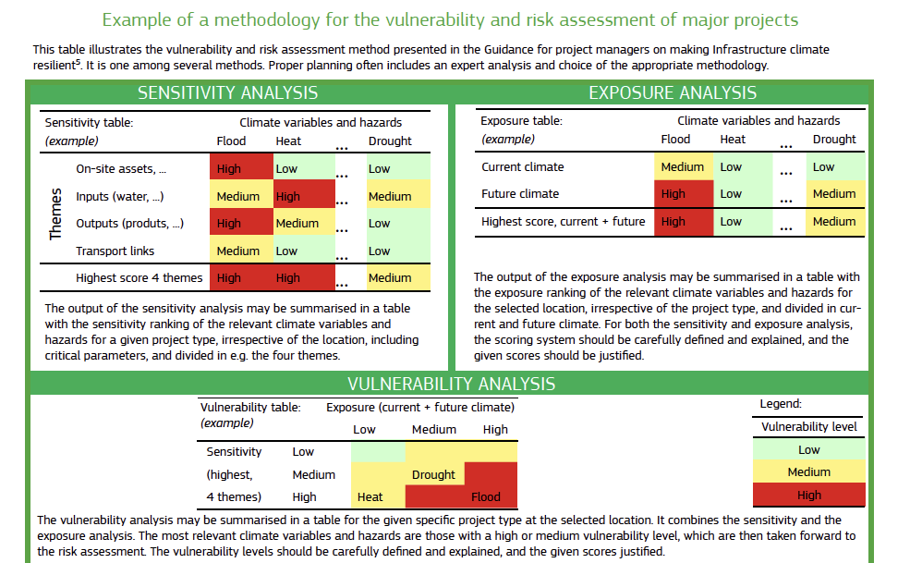

Slide 7
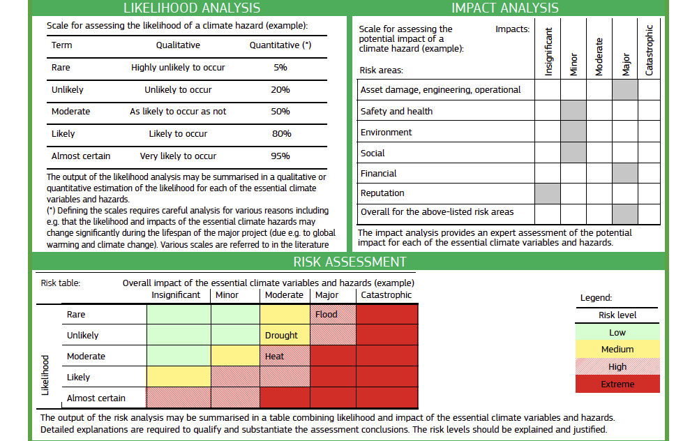

Slide 8
Source: European Commission, Climate Change and Major Projects: Outline of the climate change related requirements and guidance for major projects in the 2014-2020 programming period

Slide 9
Structural Adaptation Measures – Dam and appurtenant works
Climatic Variable | Impacts on Project Component | Potential Resilience/Adaptation Measures
Temperature | Material expansion/contraction causing cracking, leading to leakage or instability | Additional monoliths and/or construction joints • New concrete mix designs which are more resilient to temperature variations • Change of dam type/choice of construction materials • Dam concrete temperature control by pre- or post-cooling
 | Construction using certain materials (e.g. concrete placing or dam clay core) cannot take place in extreme temperatures | Construction planning to take into account extreme temperature variations, which may require additional measures during construction (e.g. ice for concrete construction) or revised construction scheduling
Notes:
Source: International Hydropower Association, 2019. Hydropower Sector Climate Resilience Guide. London, United Kingdom

Slide 10
Structural Adaptation Measures – Dam and appurtenant works
Climatic Variable | Impacts on Project Component | Potential Resilience/Adaptation Measures
Precipitation and streamflow | Reservoir slope instability causing landslides and trees to fall into reservoir | Detailed reservoir rim stability assessment leading to slope stabilisation in at risk areas
 | Change of river regime with reduced base flow and increased floods | Increased spillway capacity to allow increased flow • Consider changing operating methodology to capture increased flood in storage projects
 | Increased/decreased sediment loads impacting operating regime of reservoir | Additional flushing and sediment management facilities e.g. increased temporary storage for sediment where the reservoir is being used as a desander • Change in operation methodology • Allow excavation of coarse and sand construction material by locals at reservoir tail • Additional dredging
 | Additional floating vegetation/algae potentially clogging intakes | Consider adding overtopping facility for reservoir surface cleaning • Addition of intake trash rack rake equipment
Notes:
Source: International Hydropower Association, 2019. Hydropower Sector Climate Resilience Guide. London, United Kingdom

Slide 11
Structural Adaptation Measures – Access Roads and camps
Climatic Variable | Impacts on Project Component | Potential Resilience/Adaptation Measures
Temperature | High temperatures damage road construction | Suitable pavement materials for temperature variations
 | Increased dust on temporary or unsurfaced access roads | Increased dust suppression
Precipitation and streamflow | Heavy downpours damaging unsurfaced roads | Increased drainage Road design amendments
 | Increased decries from higher surface runoff | Debris screens added to drainage and culverts Increased maintenance
 | Increased risk of slope instability | Increased landslide hazard assessments Additional slope protection
 | Increased/decreased stream runoff | Revised route selection More robust assessment of road alignment
Notes:
Source: International Hydropower Association, 2019. Hydropower Sector Climate Resilience Guide. London, United Kingdom

Slide 12
Nature-based Solutions
What are Nature-based Solutions for Adaptation and Resilience?
Nature-based Solutions (NBS) are activities associated with the protection, management, enhancement, and restoration of nature to deliver climate resilient infrastructure
NBS can be used to safeguard traditional gray infrastructure while delivering enhanced resilience and co-benefits (e.g. climate change mitigation, supporting biodiversity and local livelihoods, food and water security)
Why choose NBS as an adaptation measure?
Ensures the sustainability of the infrastructure
Protects from hazards
Secures access to basic services & livelihoods

Slide 13
Examples of Nature-based Solutions for Adaptation for Hydropower
Tree planting
To reduce erosion on riverbanks
To reduce landslides on slopes
Forest Conservation
To protect water supply
Co-benefits for communities

Slide 14
Test Projects
1. Lower Fufu Hydropower Project (Zambezi River Basin, Malawi): a proposed run of the river hydropower facility to be built within the Rukuru River watershed in northern Malawi.
2. Polihali Dam and Conveyance Project (Orange River Basin, Lesotho): part of the second phase of the Lesotho Highlands Water Project (LHWP), the Polihali dam would be located downstream of the Khubelu and Senqu Rivers, with the main objective of the project to transfer water from a new reservoir to the existing Katse Reservoir.
3. Pwalugu Multi-purpose Dam Project (Volta River Basin, Ghana): a dam and reservoir project designed to provide electricity production, irrigation water supply for new agricultural lands, flood control, and the development of a lake fishery industry.
4. Batoka Gorge Hydropower Project (Zambezi River Basin, Zambia/Zimbabwe): a large complex project that will support power generation in both Zambia and Zimbabwe, and likely be linked to the transmission network of the Southern Africa Power Pool.
5. Mwache Dam and Reservoir Project (Kwale District, Kenya): a reservoir project designed to provide municipal water supply, with excess supply will be used for irrigation in nearby areas.

Slide 15
Test Projects Inputs
The modeling components required for a climate change analyses consist of a:
A simple project design and cost model, that can reproduce any existing cost estimates from a prefeasibility study and can estimate how costs would vary with alternative design specifications. If the complexity of the design precludes the development of a simple design and cost model, several estimates of alternative designs could be developed using the more detailed tools.
A set of downscaled climate projections for the project’s relevant geographic region.
A hydrologic model of the relevant region, calibrated to local observational records and linked to climate projections, that can estimate project inflows and operations for alternative design specifications.
Source: IPCC 6th Assessment, WGI Report, Africa Factsheet

Slide 16
Test Projects Methodology
Evaluation of range of designs based on historical climate conditions
Tradeoff analysis to assess alternative designs
Economic Analysis
Notes:
Step 1: Each study began by evaluating a range of designs under historical climate conditions. This approach is
analogous to the approach taken in a standard pre-feasibility or feasibility study, and identifies a design
that is optimized based on historical climate. This design will not necessarily coincide with the one
proposed in the project’s feasibility studies, as the latter benefit from a range of information on factor
influencing design, wider than those available to the study team of the present report. The analyses
then evaluate the climate sensitivity of the same design alternatives, or a subset, by evaluating their
performance under a broad range of plausible future conditions. These results help identify one or more
robust designs (i.e. design capable of delivering acceptable performance under a wide range of climate
scenarios). If a new feasibility analysis were to use this approach, it likely would begin with evaluation of
the larger set of climate change futures, and not emphasize the historical optimal case.
Step 2: The next step, tradeoff analysis, uses the results from the previous steps to support an assessment of
alternative designs. Analysts develop interactive visualizations that highlight the key tradeoffs among
different designs and their performance across the different futures, including the scenarios that
illuminate the key vulnerabilities. At this point in the process, additional scientific information and
expert judgment can be incorporated to provide context about the likelihoods of the key scenarios, and
stakeholder preferences about different outcomes can be considered along with the analytic results, to
help inform the selection of a robust strategy. In many cases, these deliberations identify a design that is
preliminary and contains elements that need further evaluation, refinement, or augmentation. This
preliminary robust design can then be used as a new starting point for additional iterations through the
process. In this way, RDM helps support an ongoing, iterative planning process that can accompany the
implementation over time of large and potentially costly designs choices.
Step 3: The test projects all evaluate the performance of the projects using standard feasibility metrics—such as
safe yield, firm yield, and levelized cost. In four of the five test projects a rough economic analysis was
performed to illustrate the relative effect of different climate change scenarios (all but the Lower Fufu).
These economic analyses are simplified due to the limited data and consider the cost of capital, the
timing of accrued assumed costs and benefits, and the assumed value of hydropower and water supply
yields, and they use net present value (NPV) of the project as the basis for project performance
comparisons. Any externalities, negative or positive, are not included in the economic analysis.

Slide 17
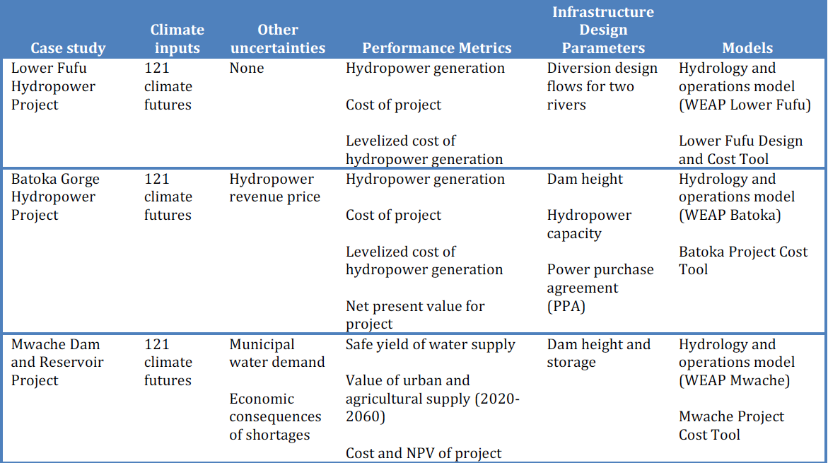
Notes:
Table 7.1 provides a summary of the uncertainties used as inputs to the analyses, the project
performance metrics, the infrastructure design parameters varied in the analysis (effectively, these are
climate adaptation levers), and the models used for the analysis. Each analysis uses a hydrology and
water management model (last column) to estimate project inflows and operations (performance
metrics in the fourth column) under each climate future (second column) and project design alternative
(in the fifth column). Each test project presented here is based on models developed in the Water
Evaluation And Planning (WEAP) system – the same system described in Chapter 2 and applied
throughout the study.

Slide 18
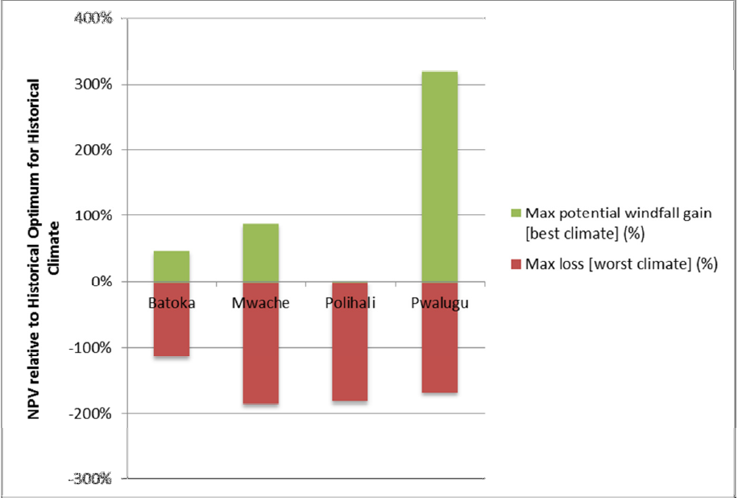
Summary of Vulnerability of Projects, before Design Adaptation

Slide 19
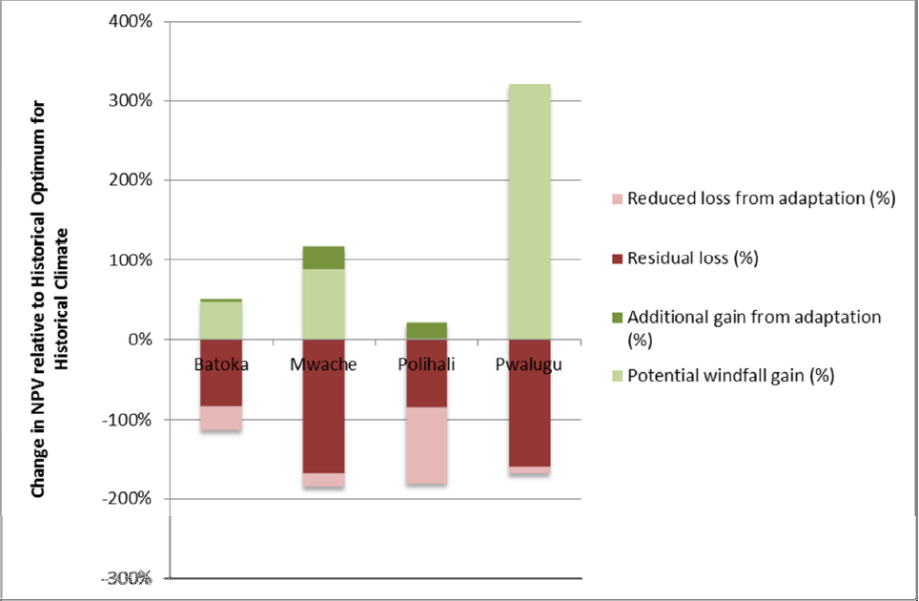
Potential Economic Benefits that Derive from Adapting Project Design

Slide 20
Conclusions based on Test Projects
Performance of project designs can be sensitive to future climate. Project design defined on the basis of historical climate conditions does not generally perform well across all plausible future climate conditions. In drier futures, smaller facilities yield higher net benefits as less investment is underutilized during the dry periods. In wetter futures, larger facilities that can better take advantage of high flow periods yield higher net benefits.
Although project performance is sensitive to climate change, the performance does not need to be vulnerable. In some cases the benefits and revenues of the water infrastructure project is so high that risk for negatively performing projects are low even in extreme future climates, or benefits do not differ significantly across the climate scenarios. It is thus important to distinguish between climate sensitivity and vulnerability. Both sensitivity and vulnerability may vary depending on what performance metrics are studied and may be heavily influenced by factors other than climate change (e.g. price and demand for power or water).
Designs appropriate for the historical climate may be robust over a wide range of climate futures if paired with flexibility in the choice of water or power contracts.

Slide 21
Breakout Groups by Hazard
Heat
Heavy Rain
Water Flow (+/-)
Any action already being taken to address this hazard?
What types of actions could be implemented now on the PIDA project?

Slide 22
Resources
International Energy Agency, Climate Impacts on African Hydropower
International Hydropower Association, 2019. Hydropower Sector Climate Resilience Guide. London, United Kingdom
World Bank, Enhanced Climate Resilience of Africa’s Infrastructure
European Commission, Climate Change and Major Projects: Outline of the climate change related requirements and guidance for major projects in the 2014-2020 programming period

