Slide 1
The Africa Climate Resilient Investment Facility (AFRI-RES) PIDA PAP II Training Programme Module 1: Climate Risks, Impacts and Vulnerability for Hydropower Projects

Slide 2
Structure of the Module
Aims of the Module
Climate Change Outlook globally
Climate Risks for Africa in medium and long term
Exercise: Using the IPCC Interactive Atlas
Expected Climate Impacts on Hydropower Infrastructure
Why Adapt?
Discussion
Glossary and Resources

Slide 3
Aims of AFRI-RES & the Training Programme
The Africa Climate Resilient Investment Facility (AFRI-RES) Objective: Strengthen the capacity of African institutions (national governments, river basin organizations, Regional Economic Communities, power pools and development practitioners) to plan, design, and implement investments resilient to climate variability and change in selected sectors
Training Programme Objectives
are well informed of climate risks to Africa’s infrastructure
understand climate resilience and its attributes and guidelines
are trained on the use of the resilience attributes and climate resilient guidelines for hydropower sector already developed through the World Bank under the AFRI-RES programme
can monitor and evaluate projects for adopting climate resilience attributes to ensure intended impacts of the projects
promote climate resilient measures to improve the quality and sustainability of projects
increase capacity on adaptive management of projects to integrate new information and knowledge on climate resilience relevant for the projects

Slide 4
Aims of Module 1
Upon the completion of Module 1, participants will have an increased understanding of climate risks and impacts for the hydropower projects in PIDA PAP II in order to utilize this information in the oversight of implementation and the monitoring and evaluation of PIDA PAP II projects.

Slide 5
Climate Change Outlook Globally
The recently released 6th Assessment Report from the Intergovernmental Panel on Climate Change (IPCC) Working Group 1 shows that emissions of greenhouse gases from human activities are responsible for approximately 1.1°C of warming since 1850-1900, and finds that averaged over the next 20 years, global temperature is expected to reach or exceed 1.5°C of warming
For the future outlook, there are different scenarios based on the extent to which mitigation of emissions is undertaken and Shared Socio-economic Pathways (SSPs) that incorporate variations in human, economic and social development
There are also different scenarios for the future including variation in mitigation of emissions and socio-economic pathways.
Notes:
More information on SSPs (https://www.carbonbrief.org/explainer-how-shared-socioeconomic-pathways-explore-future-climate-change)

Slide 6
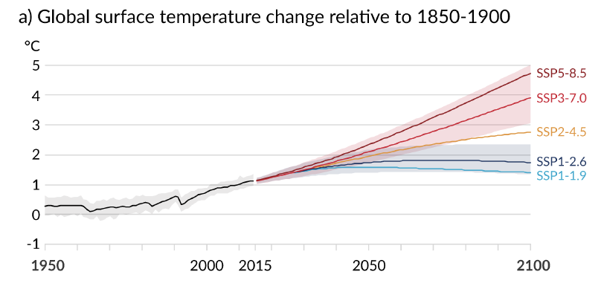
Every tonne of CO2 emissions adds to global warming
As a result, there is still a range of scenarios for the level of warming by the end of the century
Source: IPCC 6th Assessment, WGI Report

Slide 7
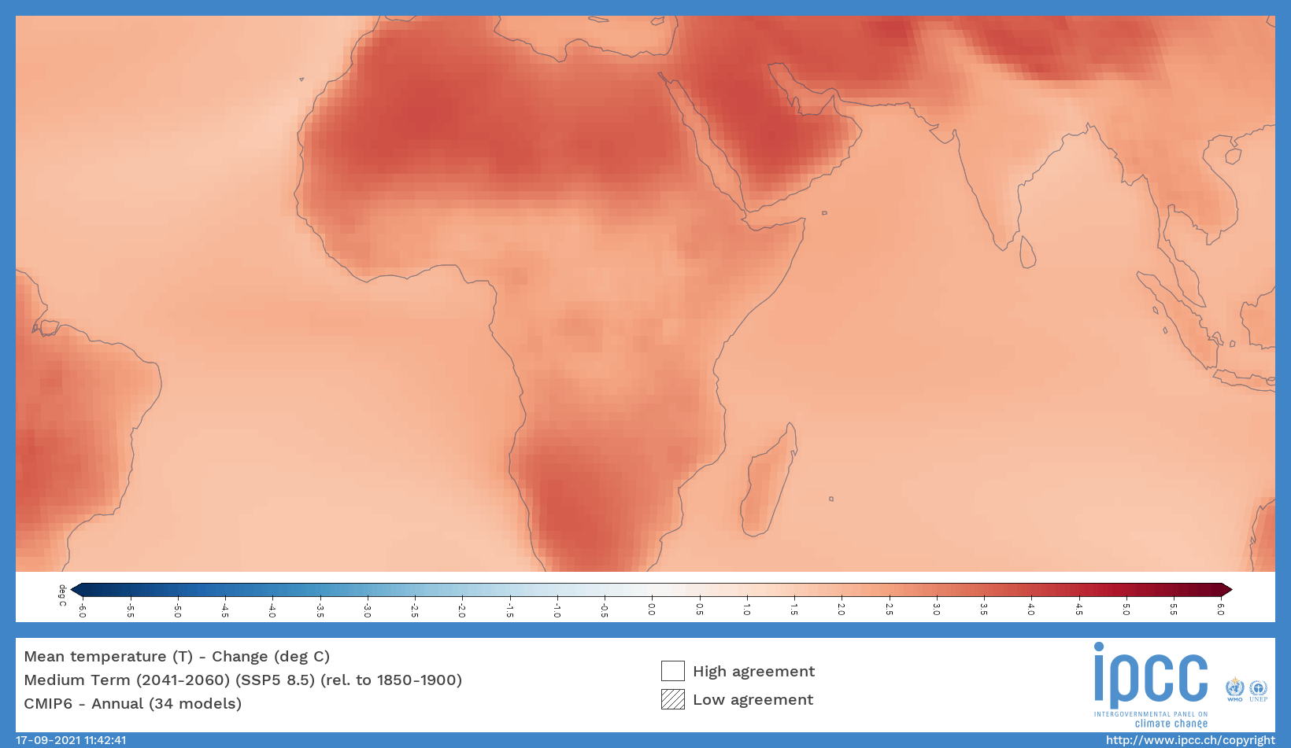
Climate Change in Africa
Notes:
https://interactive-atlas.ipcc.ch/permalink/XgwlTOwC

Slide 8
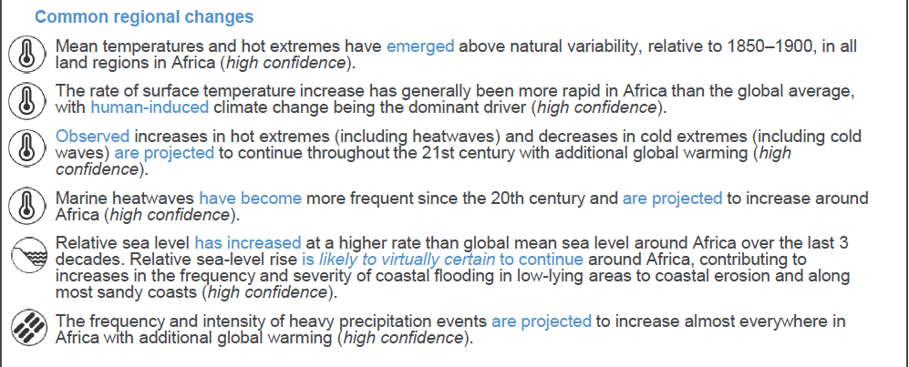
Climate Change in Africa
Source: IPCC 6th Assessment, WGI Report, Africa Factsheet

Slide 9
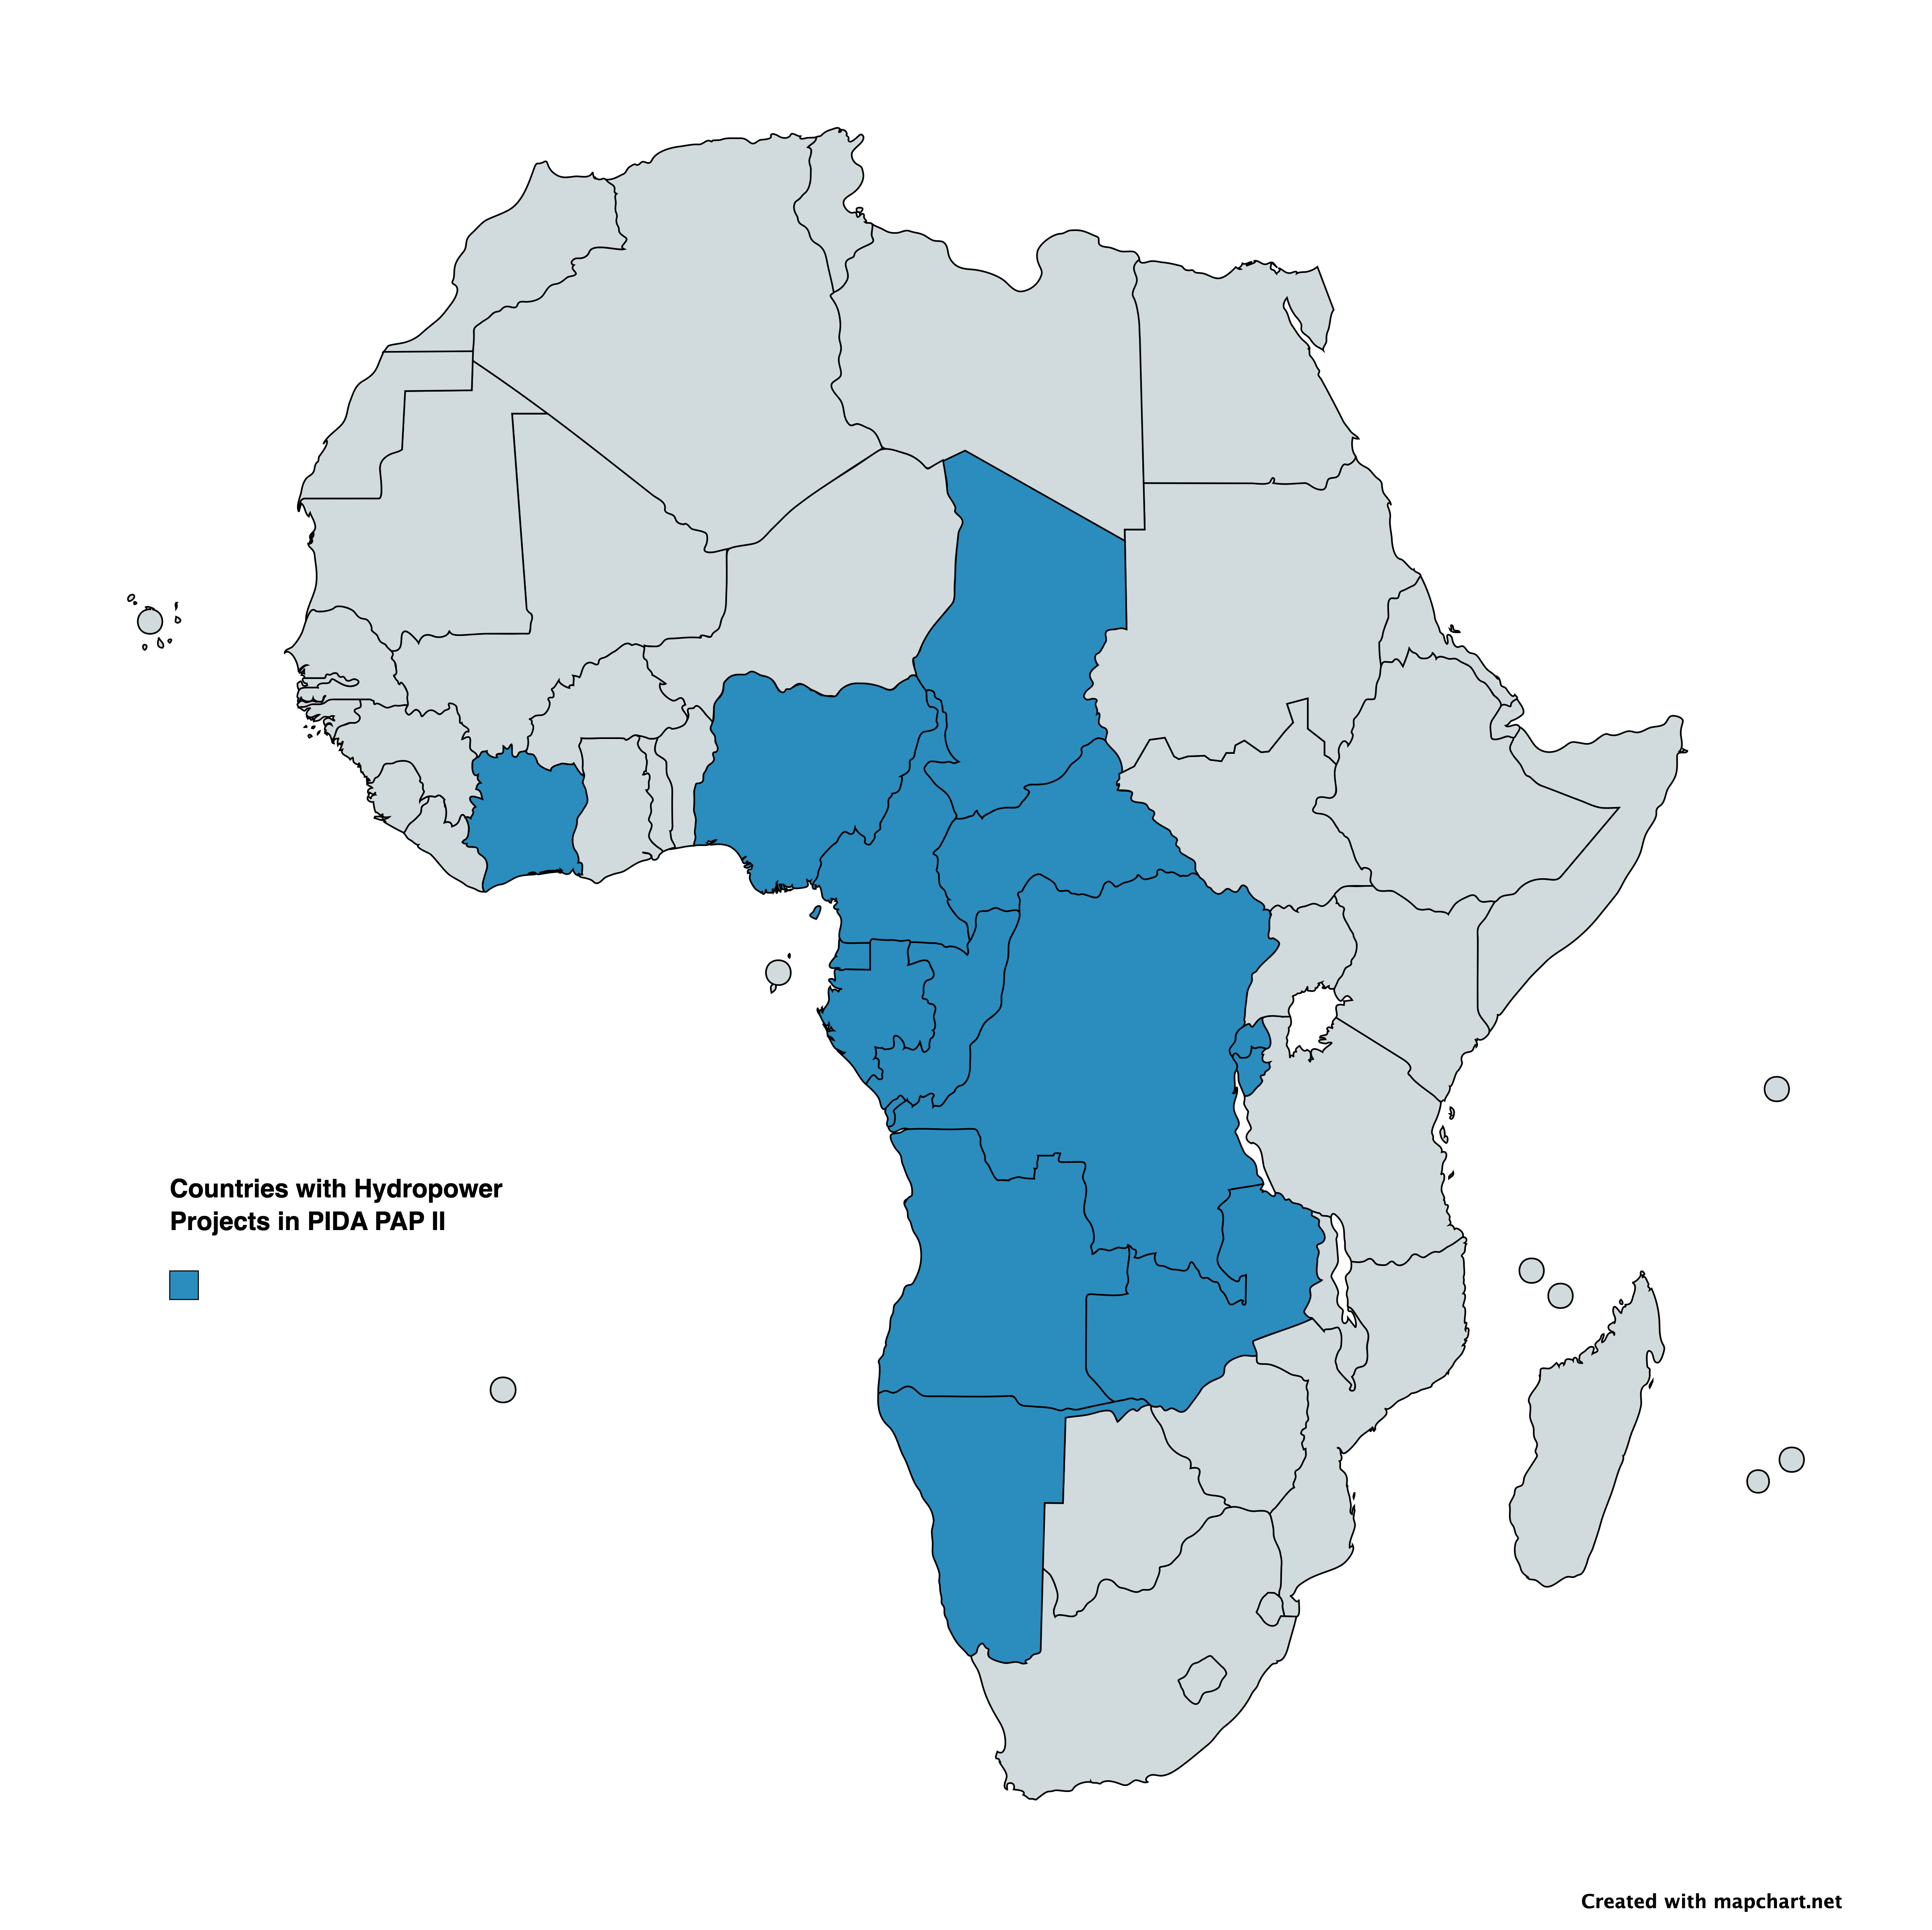
Location of PIDA PAP II Hydropower projects
PIDA PAP website

Slide 10
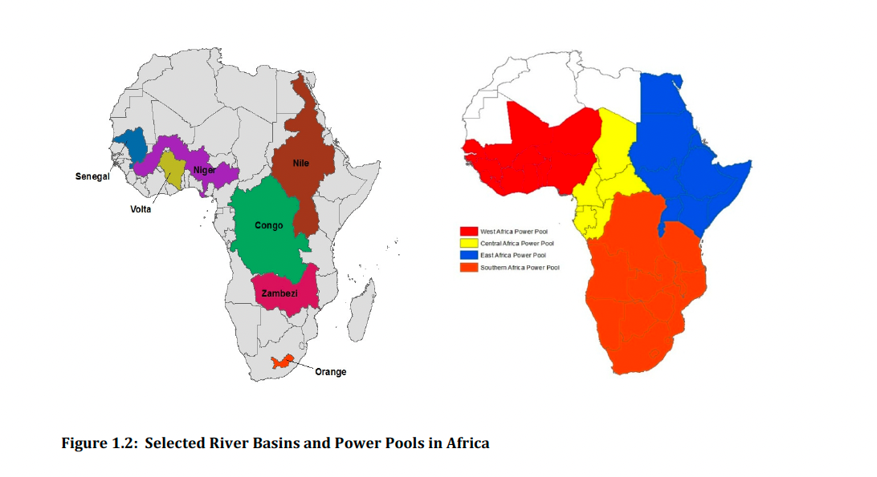
Location of River Basins and Power Pools in Africa
Source: World Bank, ECRAI report

Slide 11
Observed and projected changes in regions with hydropower projects
West Africa (WAF)
Observed increase in river flooding;
Observed increase in drying and agricultural and ecological droughts;
Projected increase in meteorological droughts at GWL 4°, mostly in seasonal timescales;
Projected increases in mean wind speed; increase in heavy precipitation and pluvial flooding.
Central Africa (CAF)
Observed decreases in mean precipitation;
Observed decrease in standardized precipitation index (i.e deficit of precipitation);
Observed increase in agricultural and ecological droughts;
Projected increases in heavy precipitation and pluvial flooding; increases in river flooding.
West Southern Africa (WSAF)
Observed decrease in mean precipitation;
Observed increase in heavy precipitation and pluvial flooding;
Observed and projected increase in aridity, agricultural and ecological droughts;
Projected increase in dryness from 1.5°C, higher confidence with increasing global warming;
Projected increases in mean wind speed; increases in fire weather conditions.
Source: IPCC 6th Assessment, WGI Report, Africa Factsheet

Slide 12
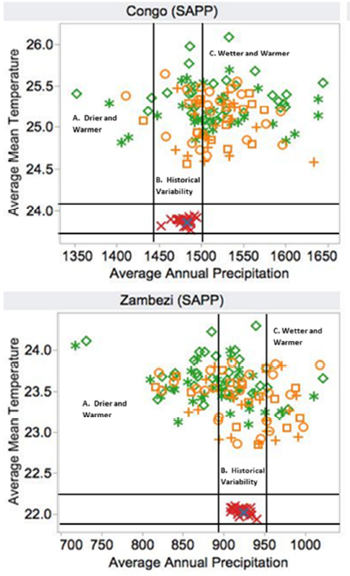
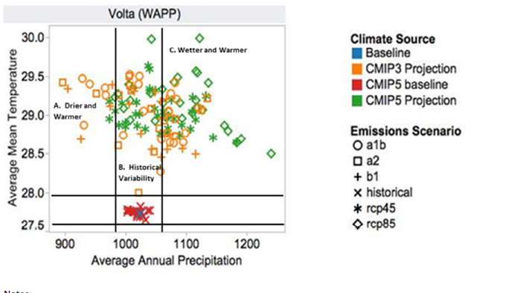
Variation in outcomes for water basins remain for precipitation levels but increase in temperature is consistent across projections
Source: World Bank, ECRAI report
Notes:
In some countries, there is a considerable level of uncertainty in assessing potential climate impacts on hydropower due to a lack of historical observation data and low agreement among climate scientists. Moreover, even when the data is available, public officials and utilities, particularly those in rural areas, have a low capacity to assess climate risks and impacts, and integrate the results into the planning and implementation of hydropower projects. Projects that are not attentive to climate impacts are likely to have difficulties in managing the stress created by a changing climate.

Slide 13
IPCC Working Group 1: Interactive Atlas Activity
The atlas can be found here: https://interactive-atlas.ipcc.ch/permalink/XgwlTOwC
Step 1: Zoom into your region or country
Step 2: Select with Models- Historical and Projections that you want to utilize
Step 3: Decide which variable you are interested in (Mean Temperature, Total Precipitation, Consecutive Dry Days, etc)
Step 4: Select which period you want to cover (near term, medium term, long term)
Step 5: Select which emissions scenario (SSP5 – 8.5 is high; SSP2 – 4.5 is medium; SSP1 – 2 is low)
Step 6: Generate map
Optional: Change some of the selections above and generate a different map

Slide 14
Vulnerability of the African Hydropower Sector
Vulnerability stems from the sensitivity and limited adaptive capacity of a power system and the stakeholders involved in the system.
 | Sensitivity | Adaptive Capacity
Definition | The extent to which a system is impacted by a sector or a source that could be negatively affected by climate hazards | Refers to the ability of a system and stakeholders to anticipate, prepare for and plan in advance to cope with potential climate impacts.
African Hydropower Sector | Restricted water availability; Water scarcity that results in hydropower competing with other water uses | Public officials and utilities in the majority of African countries, particularly those in rural areas, have low levels of adaptive capacity; some of them are already experiencing difficulties in coping with the current level of climate variability (IPCC, 2014a).

Slide 15
Impacts on the Hydropower Sector in Africa
Hydropower is particularly susceptible to the adverse impacts of climate change
because it is directly affected by changing patterns in rainfall and temperatures. For instance, hydropower generation output can fluctuate due to variations in the mean annual streamflow, shifts of seasonal flows, and increased evaporation from reservoirs (IPCC, 2014a). Therefore, an increasing reliance on hydropower could mean a higher probability of exposure to climate hazards.
The increasing likelihood of extreme weather events could also raise the level of climate risk on African hydropower. When tropical cyclone Idai hit the east coast of Africa, the flooding and excessive debris caused two major hydropower plants in Malawi to go off line, reducing Malawi’s hydropower capacity from 320 MW to 50 MW (Centre for Disaster Philanthropy, 2019; The Watchers, 2019).

Slide 16
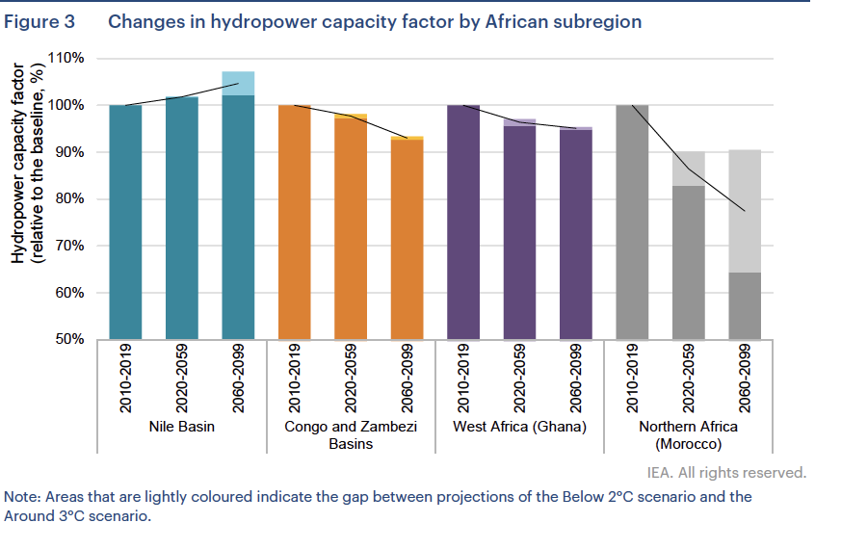
Source: IEA, Climate Impacts on African Hydropower

Slide 17
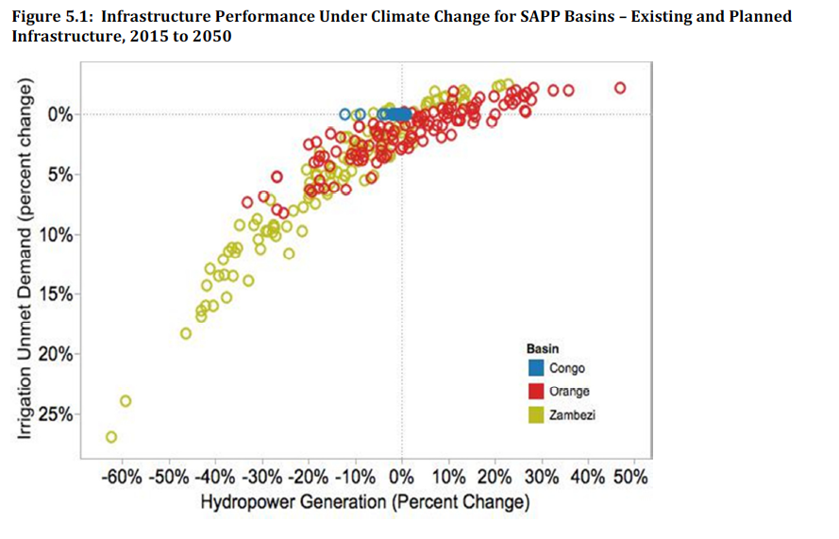
Notes:
The results in Figure 5.1 show that under the driest scenarios, which are in the lower left corner,
hydropower generation could decline by more than 60%, and unmet irrigation demand could decline by
more than 25% in the Zambezi basin. The benefits of wetter scenarios in the Zambezi basin, in the
upper right corner, suggest an increase of up to 25% in hydropower production and a few percent in
irrigation water provision. Results for the Orange are more balanced, with hydropower production outcomes clustering the +/- 20% range, and unmet irrigation demand of no more than 10%. The Congo
results show much less sensitivity to climate – this already wet basin could see hydropower reduced by
up to 15% in one climate future, and 10% in one other climate future, but the vast majority of the other
almost 120 climate futures for the yield results within a few percent of that in the Congo reference case.
Certainly, the results vary dramatically by basin, but overall climate change could be an important factor
in water and power infrastructure performance in the SAPP.

Slide 18
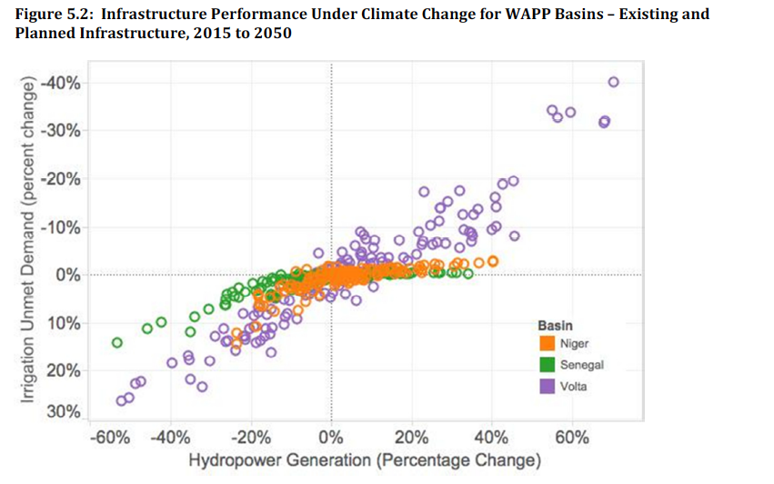
Notes:
The results for the WAPP, in Figure 5.2, show high relative climate sensitivity of infrastructure in the
Volta basin for both hydropower and irrigation, and somewhat lower climate sensitivity in the Senegal
(though with a skew toward drier scenarios and underperformance) and the Niger. In Figure 5.3 for the
Nile, we see a high degree of climate sensitivity for the both the Eastern Nile and Equatorial Lakes subbasins
for hydropower, and high sensitivity for irrigation in the Eastern Nile, but low sensitivity for
irrigation in mostly rainfed agriculture of the Equatorial Lakes sub-basin.5

Slide 19
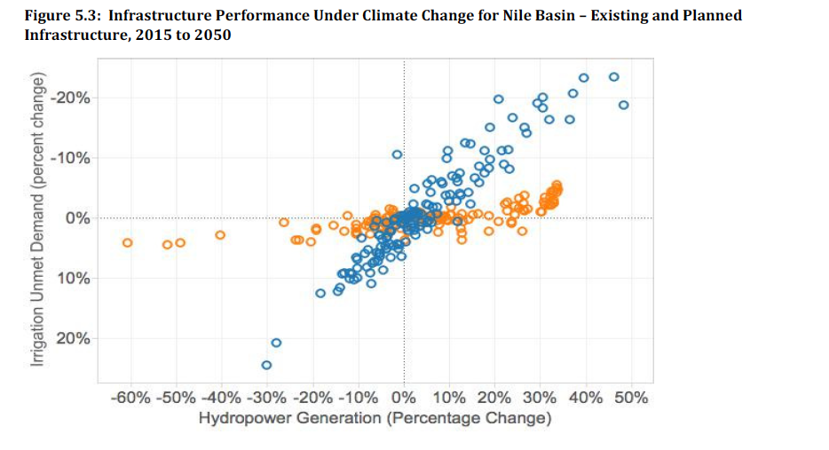

Slide 20
Energy Generation
Climatic Variable | Impacts or stressors on project component | Indicators | Timescale
Precipitation and Streamflow | Hourly generation levels (shift from evening to mid-day peak) and seasonal levels (change from winter to summer peak) | Change in grid requirements resulting in changes to power purchase agreements (PPA) or plant operations | Gradual, long-term
 | System load factor changes (ratio of peak MW to average) | Energy output | Gradual, long-term
 | Impacts on other technologies (reduced thermal due to cooling water temperature/ availability, output of renewables)
 | Changes in downstream water releases and lower minimum environmental flows | Damages to fish habitat Daily flooding | Gradual, long-term
Source: International Hydropower Association, 2019. Hydropower Sector Climate Resilience Guide. London, United Kingdom

Slide 21
Access Roads and Camps
Climatic Variable | Impacts or stressors on project component | Indicators | Timescale
Precipitation and Streamflow | Heavy downpours damaging unsurfaced roads | Damage to roads Increased surface water on roads | Extreme, sudden
 | Increased flows in culverts and road/ camp drainage | Flooding around culverts/crossings and camps | Gradual, long-term
 | Increased risk of slope instability (surface water triggered failures and ground water induced failures) | Slope movement from monitoring Surface failures causing road damage (rockfalls, mudslides)
Source: International Hydropower Association, 2019. Hydropower Sector Climate Resilience Guide. London, United Kingdom

Slide 22
Reservoir
Climatic Variable | Impacts or stressors on project component | Indicators | Timescale
Precipitation and Streamflow | Reservoir slope instability causing landslides into reservoir | Slope movement from monitoring Surface failures causing damage (rockfalls, mudslides) Failures into reservoir causing displacement waves | Extreme, sudden
 | Increased trash and vegetation in reservoir from increased runoff | Increased volume of trash in reservoir | Gradual, long-term
 | Increased water temperature (fouling, oxygen content, stagnation) | Unexpected variations in reservoir temperature Reduced oxygen levels Stagnation and fish kills
Temperature | Increased evaporation losses (absence of ice cover, drier air), leading to reduced water for generation | Increased reservoir losses Reduced energy output | Gradual, long-term
Source: International Hydropower Association, 2019. Hydropower Sector Climate Resilience Guide. London, United Kingdom

Slide 23
Waterways (e.g. delivery canals)
Climatic Variable | Impacts or stressors on project component | Indicators | Timescale
Precipitation and Streamflow | Increased flows through waterways | Spilling from waterways Damage to waterway structures and gates | Extreme, sudden
 | Increased risk of slope instability (surface water triggered failures and ground water induced failures) | Slope movement from monitoring Surface failures causing damage (rockfalls, mudslides) | Extreme, sudden
 | Increased sediment deposition leading to diminished flows and loss of storage and hence depleted peaking energy in storage plants | Sediment deposition
Temperature | Material durability issues and expansion/ contraction causing cracking, leading to leakage, instability or aesthetic issues | Damage to concrete | Gradual, long-term
Source: International Hydropower Association, 2019. Hydropower Sector Climate Resilience Guide. London, United Kingdom

Slide 24
Why Adapt
If the expansion of the share of hydropower occurs without assessing the potential impacts of climate change, it increase a country’s exposure to climate hazards and risks to electricity systems
For example, the hydropower capacity factor in Morocco, Zambia, Zimbabwe, the Democratic Republic of Congo and Mozambique are projected to decline considerably, while the decrease would be offset by an increase in the hydropower capacity of the Nile basin countries, notably Egypt, Sudan and Kenya (based on current not future plants)
Another challenge caused by climate change is the increased year-to-year variability in hydropower capacity factors.
Currently, 17% of electricity is generated from hydropower. This share is
expected to increase to more than 23% by 2040 as a result of ongoing efforts to meet both climate goals and universal access to electricity (IEA, 2019). Indeed, Africa still has enormous remaining hydropower potential which is technically and economically feasible. Therefore, many countries have initiated new projects to tap into the continent’s enormous hydropower potential.
Source: IEA, Climate Impacts on African Hydropower
Notes:
The long lifespan of hydropower assets, which generally ranges from 50 to 100 years, mandates that new hydropower projects consider the long-term implications of climate change (Trace, 2019). During the lifespan, most African hydropower plants are likely to be increasingly exposed to climate impacts. Given the growing role of hydropower in the continent, the issue of increasing exposure needs to be taken into account from the initial planning to the overall management of hydropower.
Impacts: assuming no adaptation, what is the range of impacts that will be caused by the different climate futures, in relation to the physical and/ or monetary targets defined in the development
baseline?
It is important to note that climate change might cause two types of impacts. The first is a lower
provision of services that will happen if the climate turns out be to be “drier” than planned. In this
case, less hydro-power generation and/or less irrigation will be possible than planned, and thus
there will be a cost in term of loss of revenues. In the second case (a “wetter” than planned future
climate), there would be the possibility of generating more hydro-power (or irrigating more
hectares) than planned based on historical climate. Thus there will be an opportunity cost, i.e. the
revenues foregone by not installing the extra hydro-power capacity or the extra hectares of
irrigation.

Slide 25
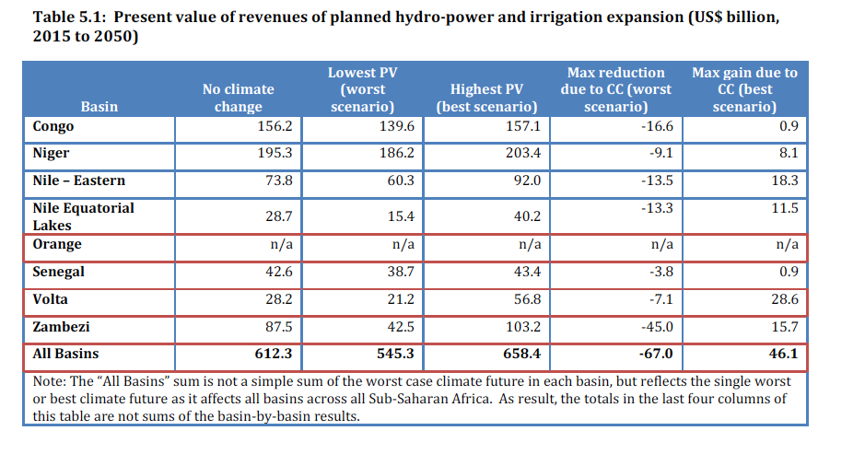
Why Adapt: Economic Impact
Notes:
Table 5.1 below provides a summary of the climate change analyses across all basins. With no climate
change, new infrastructure investments have the potential to generate over $600 billion in revenues
over the period 2015 to 2050 over the seven basins (second column of the table) – with climate change,
this is potential for almost $60 billion in losses relative to the Reference, no climate change scenario,
and also almost $60 billion in “windfall” gains from climate change. Although these estimates are made
using a no adaptation assumption, the “windfall” may require some action to realize those revenues, for
example a restructuring of power purchase agreements and/or investments to ensure newly available
hydropower generation or irrigated crops can be brought to market at reasonable prices. The potential
costs of inaction, shown in the 5th column, are greatest in the Zambezi basin, with cumulative costs as
large as $43.3 billion in the driest scenarios, and losses could also be large in the Nile ($24.8 billion) and
Congo ($12.3 billion) basins.

Slide 26
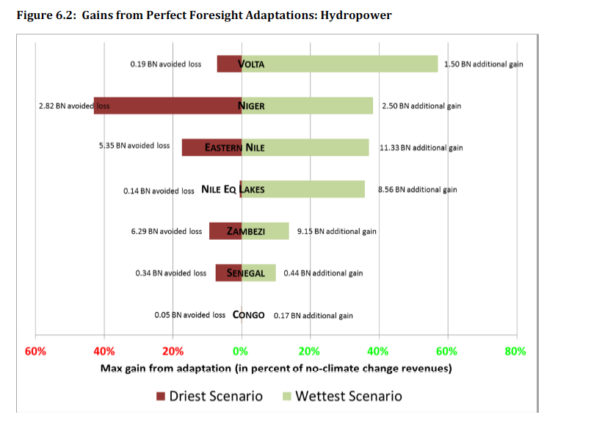
Notes:
Overall, these results suggest that in each basin, adaptation has great potential to alleviate losses,
and expand opportunities, of climate change. For example, adaptation in the Zambezi has great
potential to alleviate losses – gaining back $6.3 billion of potential losses in a dry scenario, and
adding $9.1 billion in gains in wetter scenarios – as does adaptation in the Senegal. The Nile and
Volta basins have both have high “upside” adaptation potential, as infrastructure performance in
wet scenarios can be markedly increased through adaptation, but much less potential for adaptation
in dry scenarios. The potential for adaptation to reduce losses and increase gains is reviewed for all
basins in Table 6.1, covering both hydropower and irrigation expansions.

Slide 27
Case Study Example: Zambezi Basin: The Multi-Sector Investment Opportunity Analysis and Related Studies
The Multi-Sector Investment Opportunity Analysis (MSIOA) provides an example of a stakeholder-driven basin-scale investment analysis which includes consideration of multi-sector tradeoffs in water resource investments (hydropower and irrigated agriculture). The initial study explored these tradeoffs to hone the investment strategy and balance hydropower and irrigation investments with consideration of economic returns, employment implications, and flood control. In a follow-on study, a more detailed look at climate change was conducted. That assessment, focused on evaluation, in light of potential future climate change, of one investment scenario of interest in that study, which reflected a gradual increase in irrigation-equipped area based on existing national plans and programs, together with development of new hydropower plants in accordance with a plan put forward by the Southern African Power Pool (SAPP). The MSIOA incorporated a static assessment of the effects of climate change on this scenario, based on a few scenarios of changes in air temperature (affecting reservoir evaporation) and estimates of in-stream flow derived from other work, while the follow-on study demonstrated how a more rigorous assessment of a full range of possible climate change outcomes for the region, including monthly temperature, precipitation, and runoff estimates, could affect outcomes. The analysis yields the following key insights:
• Returns to both hydropower and irrigation investments would be significantly affected by climate change, in
virtually all areas of the Zambezi basin, by as much as 10 percent basin-wide by 2030, and by 35 percent basinwide
by 2050.
• The greatest risks to firm hydropower are in the Upper Zambezi region, which includes Kariba dam, and the KafueRiver region, which includes Kafue Gorge hydropower. Climate change also presents significant risks to irrigation investments - unmet irrigation demands for the dry scenario were found as high as 15 percent in the Early Century and 22 percent in the mid-Century in the Zambezi at Cahora Bassa and Lower Zambezi sub-basins, above and beyond those projected for baseline climate.
Source: World Bank, Enhanced Climate Resilience of Africa’s Infrastructure

Slide 28
Discussion Topics
What are impacts of climate change that you are experiencing in your country?
What data and knowledge gaps are there that limit the capacity to assess climate impacts?
Which impacts are you most concerned will affect hydropower generation in your country or region?
What do you see as the main costs of adapting hydropower projects to climate change? What would be the costs of inaction?

Slide 29
Glossary
Resilience is defined by the Intergovernmental Panel on Climate Change (IPCC) as the capacity of social, economic and environmental systems to cope with a hazardous event or trend or disturbance, responding or reorganizing in ways that maintain their essential function, identity and the capacity for adaptation, learning and transformation.
Climate risk indicates the factors which are associated with the potential
consequences of climate change. According to the Intergovernmental Panel on
Climate Change (IPCC), it results from the interaction of hazard, exposure and
vulnerability (IPCC, 2014a).
Hazard refers to the potential occurrence of physical impact from changes in long-term climate trends or extreme weather events. For instance, if a country is projected to experience an increased frequency of intense climate-related events, the level of hazard will increase.

Slide 30
Exposure indicates the presence of assets, services, resources and infrastructure that could be adversely affected. For instance, if a power system has most of its grids located in a coastal area, it can be considered more exposed to climate risks of sea-level rise or coastal flooding than a system located further inland
Vulnerability is the propensity or predisposition to be adversely affected. It includes sensitivity to climate change impacts and lack of adaptive capacity which refers to the ability of a system to anticipate, prepare for and plan effectively for climate change. (DFID, 2011). If a power system is well equipped with a robust data system and capable human resources to anticipate and adapt to climate change impacts, the system can be considered less vulnerable.

Slide 31
Resources
International Energy Agency, Climate Impacts on African Hydropower
International Hydropower Association, 2019. Hydropower Sector Climate Resilience Guide. London, United Kingdom
IPCC (2021), Sixth Assessment Report, Working Group I
World Bank, Enhanced Climate Resilience of Africa’s Infrastructure

